Slide 1
Building a Knowledge Graph and AI Chatbot
Sam Yang
October 2nd, 2024

Slide 2


Interact with Graph using AI
Convert unstructured text to structured graph
Ask questions using natural language (e.g., English)
Graph Database
Execute Python
+

Slide 3
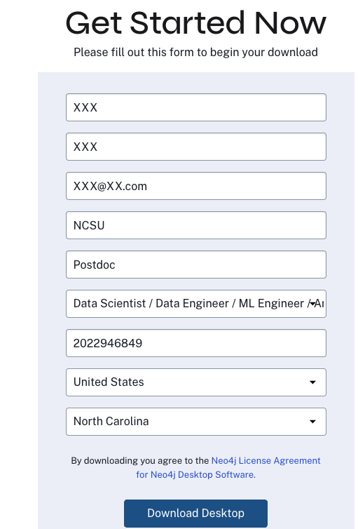
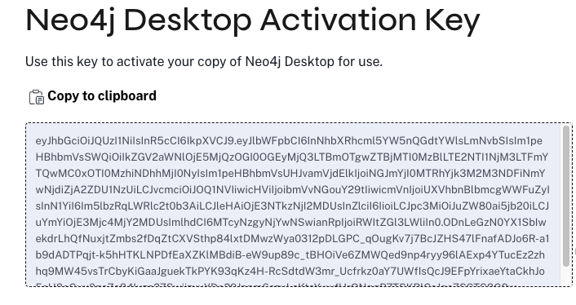

Download & Install Neo4j
https://neo4j.com/download/
It will automatically detect your computer’s operations system
Install

Slide 4
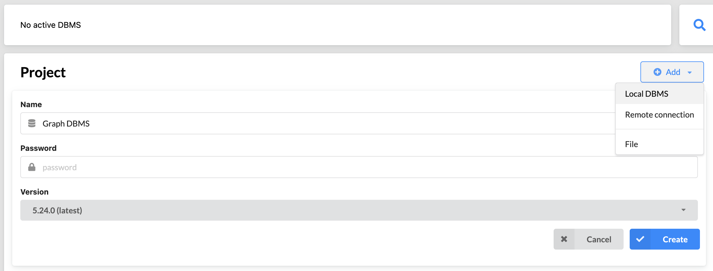
Create a Neo4j Project
Choose Local DBMS
Set a password (Remember this password! You will need to use it later)
Select the latest version

Slide 5
Create a Neo4j Project
Choose Local DBMS
Set a password (Remember this password! You will need to use it later.)
Select the latest version

Slide 6
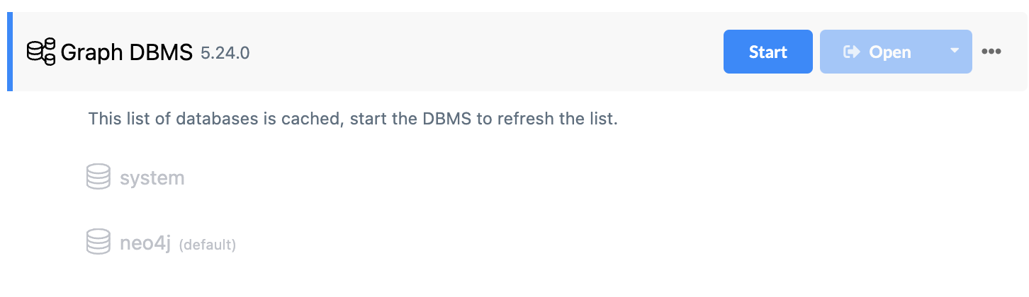
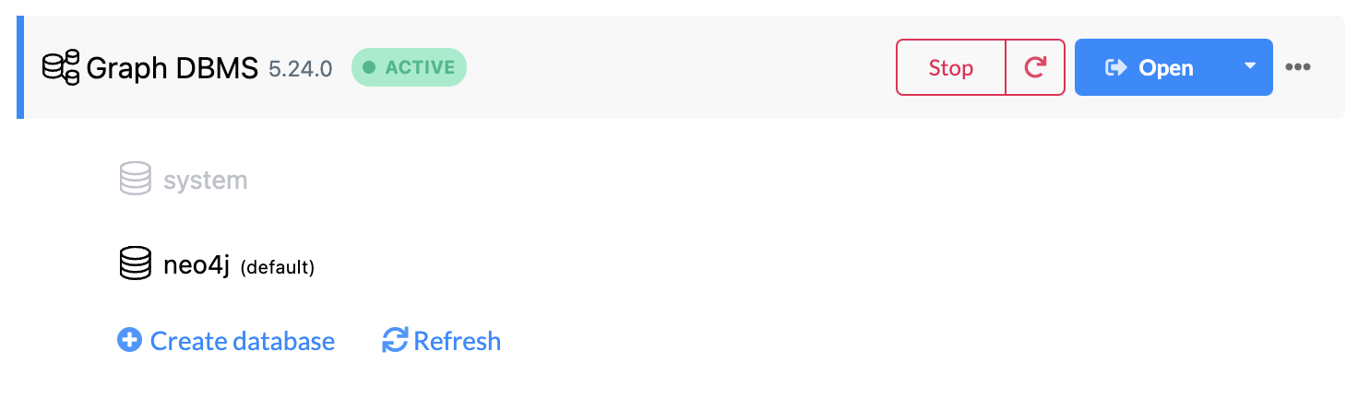
Start a Neo4j Project
Click “Start” button
Now it is active
Open it

Slide 7
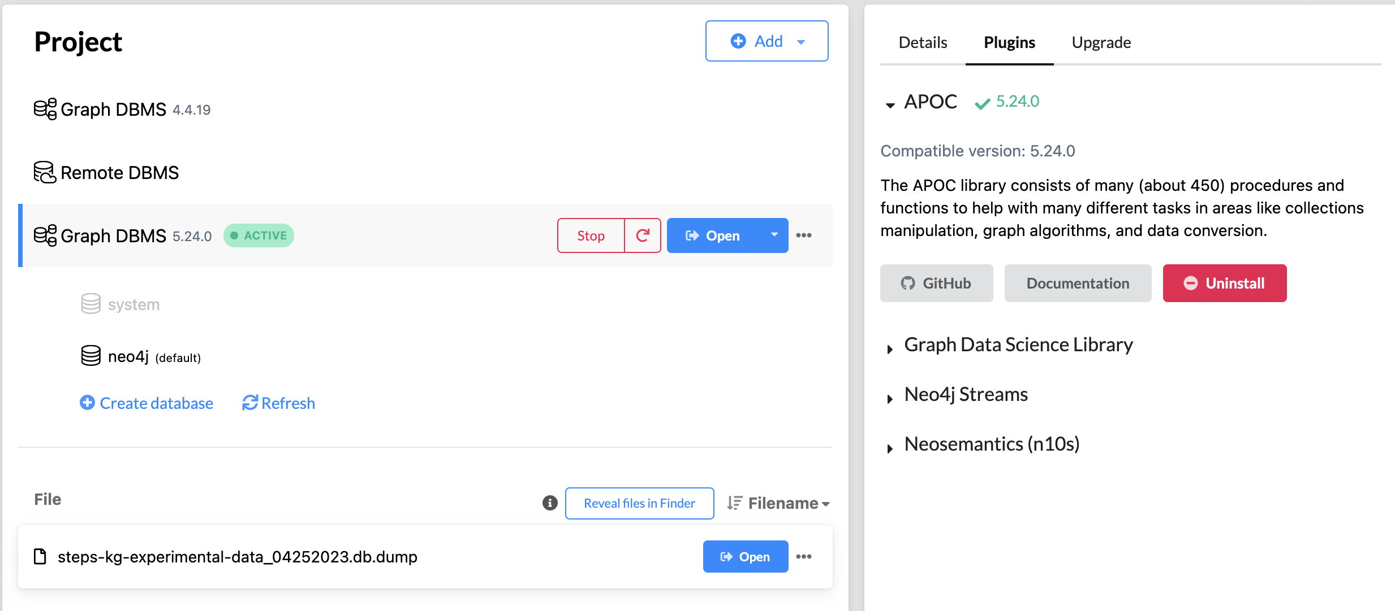
Install Plugins & Open Project
Click on the name of the project, a new window opens on the right
Under Plugins tab, install APOC
Then click Open to open the project

Slide 8
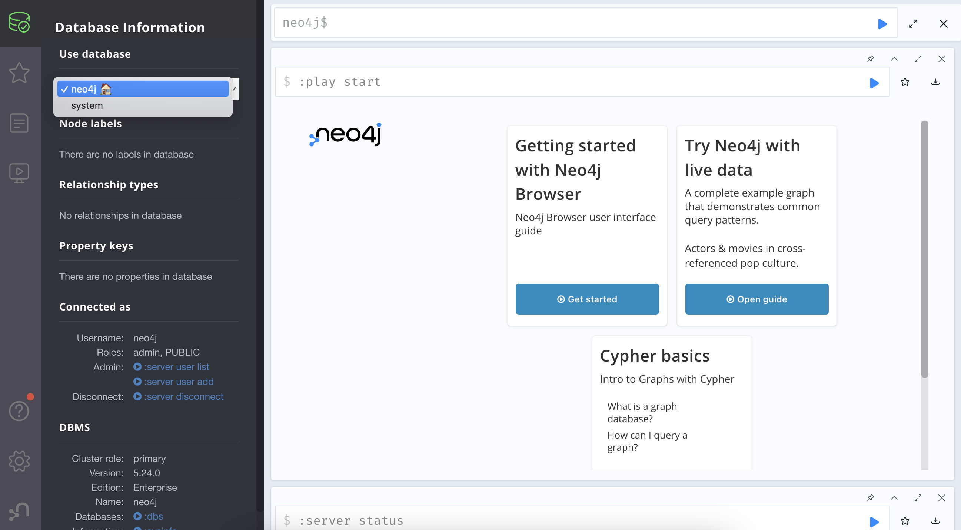
Open a Database
neo4j is the default database
If you want, you can create a database using Cypher command: CREATE DATABASE <database-name>;

Slide 9
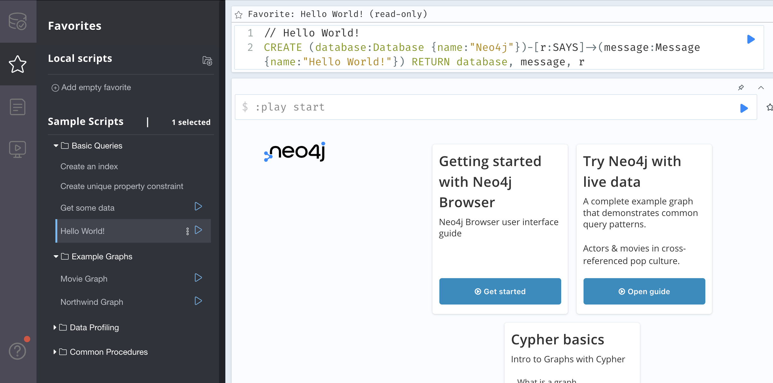
Try Some Example Cypher Commands

Slide 10
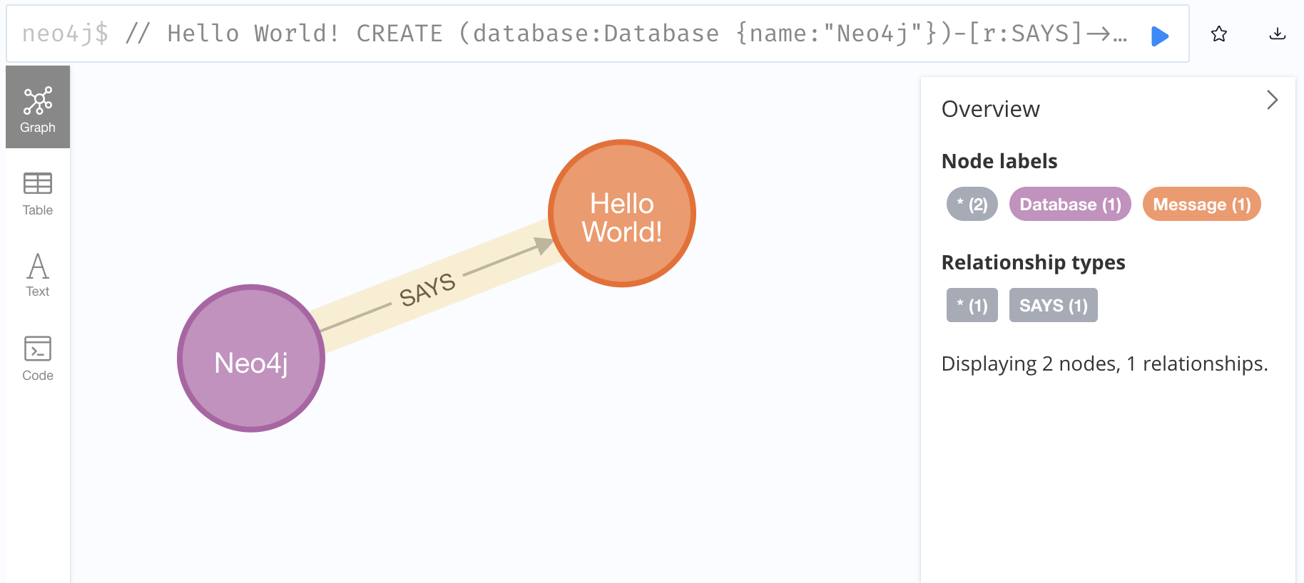
First Graph Created
A node is an entity, and an edge is a relationship
Neo4j says Hello World!
a node
another node
an edge
Now, it is straightforward to see relationships

Slide 11

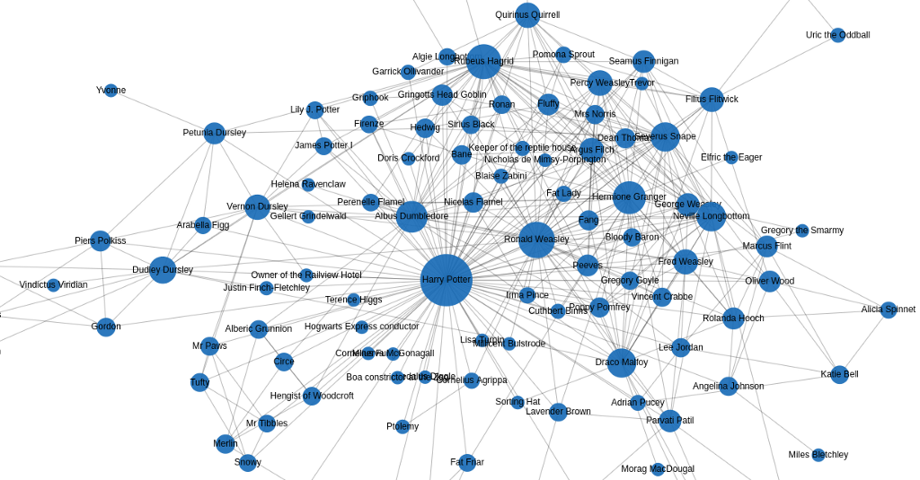
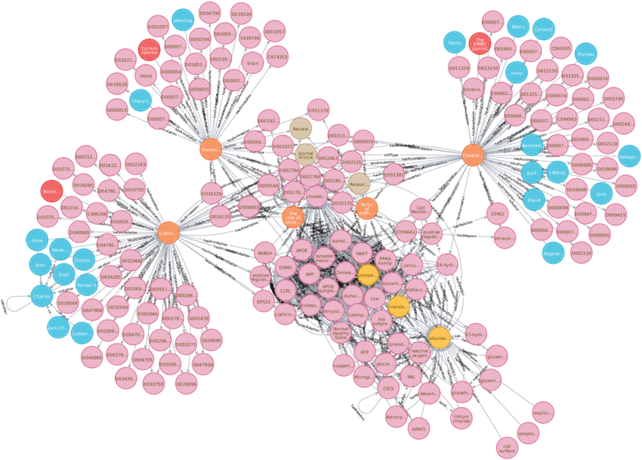
Larger Graphs
No longer easy to tell the relationships

Slide 12


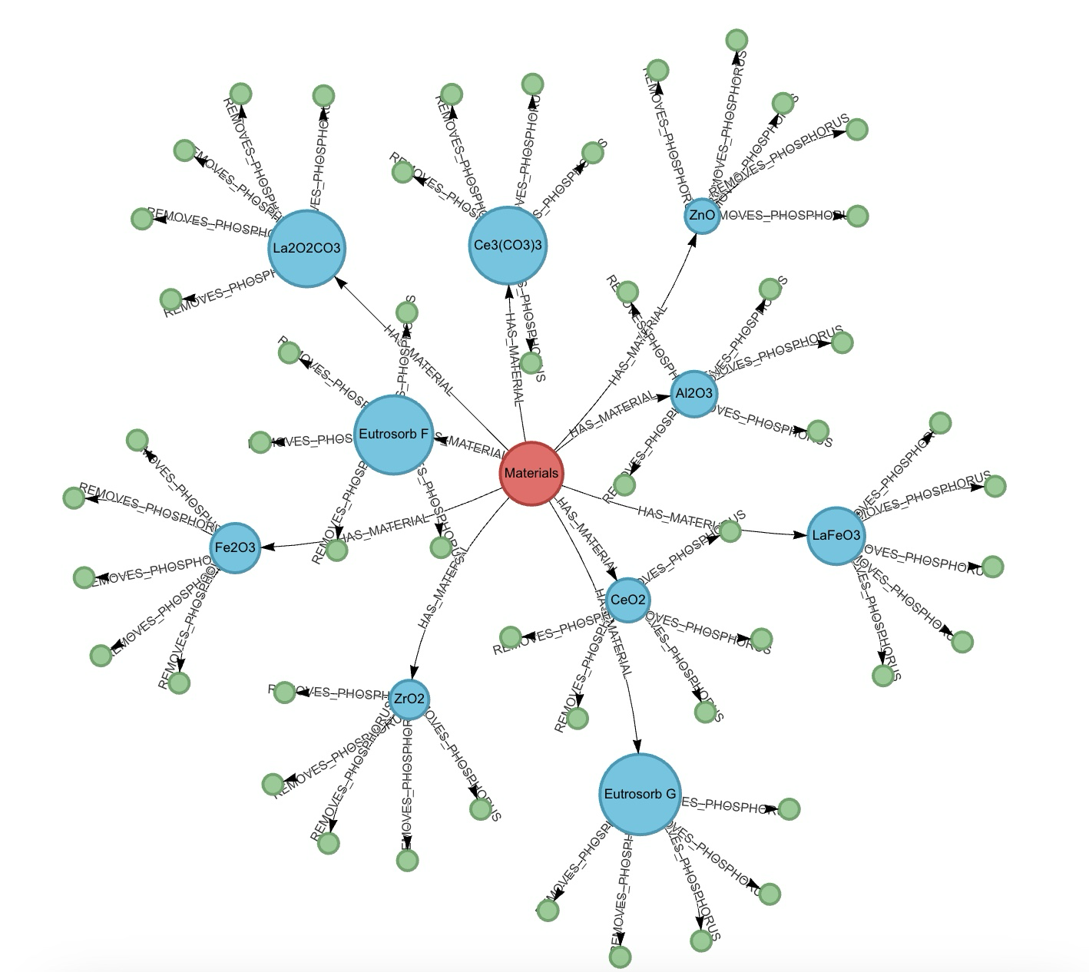


Interact with Graph using AI (Human Language)
Show the graph related to phosphorus
Sure. Here is the graph related to phosphorus (P):
What materials have phosphorus absorption > 95%
They are La₂O₂CO₃, Ce₃(CO₃)₃, ZnO, Fe₂O₃, etc. Here is the relevant graph:
Make a table of this data.
↑

Slide 13
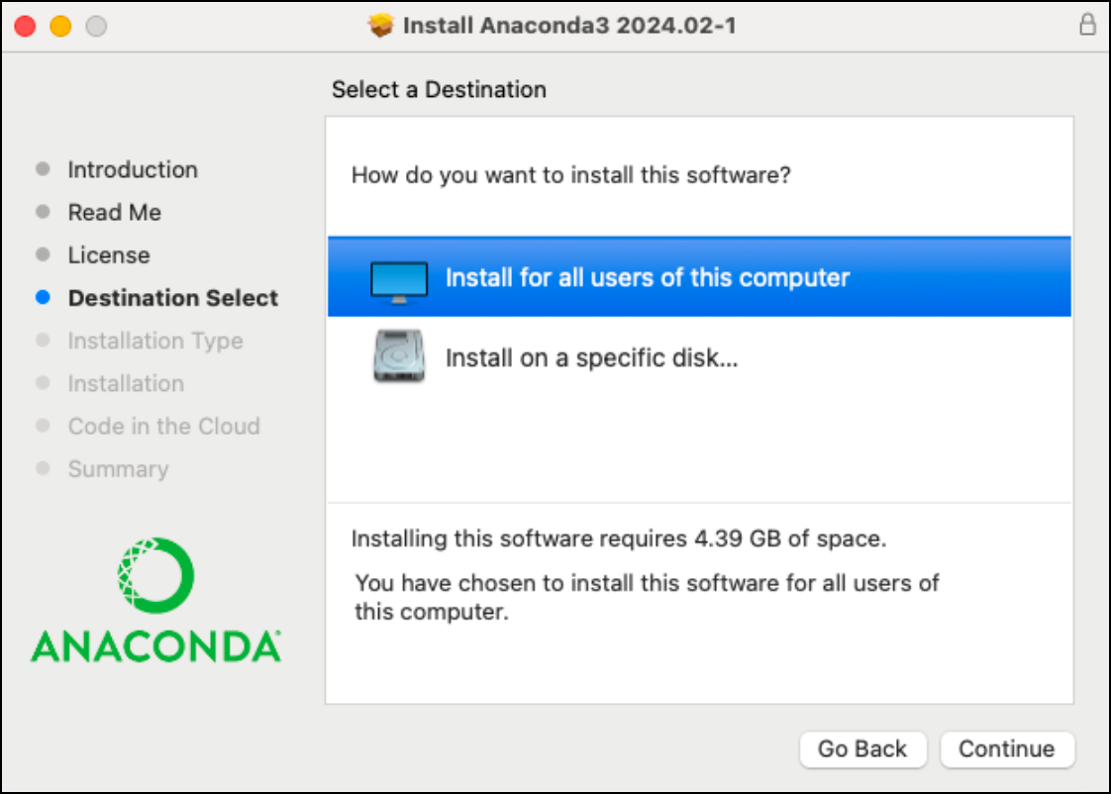
Install Anaconda
Windows: https://docs.anaconda.com/anaconda/install/windows/
Mac: https://docs.anaconda.com/anaconda/install/mac-os/
Linux: https://docs.anaconda.com/anaconda/install/linux/
Anaconda is an open-source distribution of the Python and R programming languages for data science that simplifies package management and deployment.

Slide 14
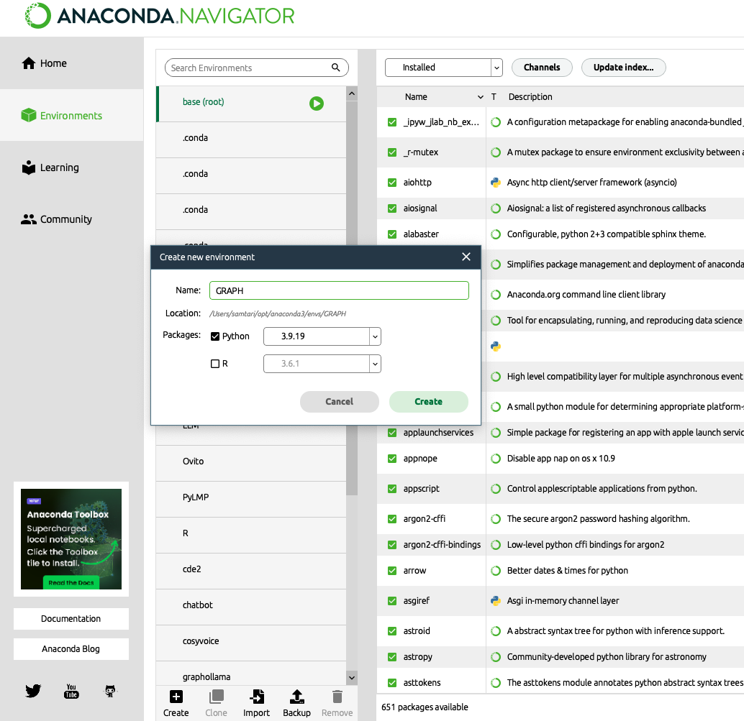
Create a Virtual Environment

Slide 15
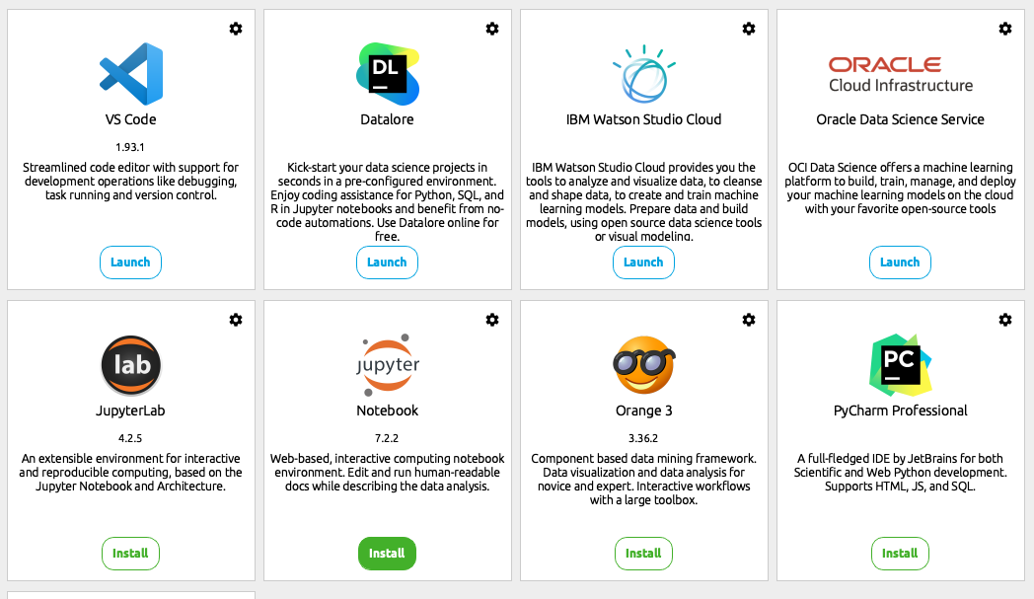

Install & Launch VS Code
Launch VS Code to
Run Jupyter Notebook
Install Jupyter Notebook

Slide 16
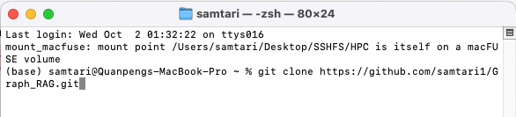
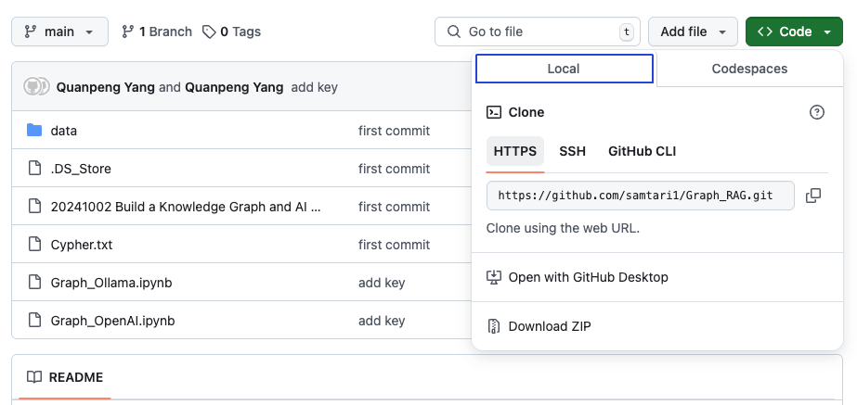
Clone Code
The code is in my GitHub repository:
https://github.com/samtari1/Graph_RAG
You can download it by executing in your terminal:
git clone https://github.com/samtari1/Graph_RAG.git
Or
Downloading directly:

Slide 17
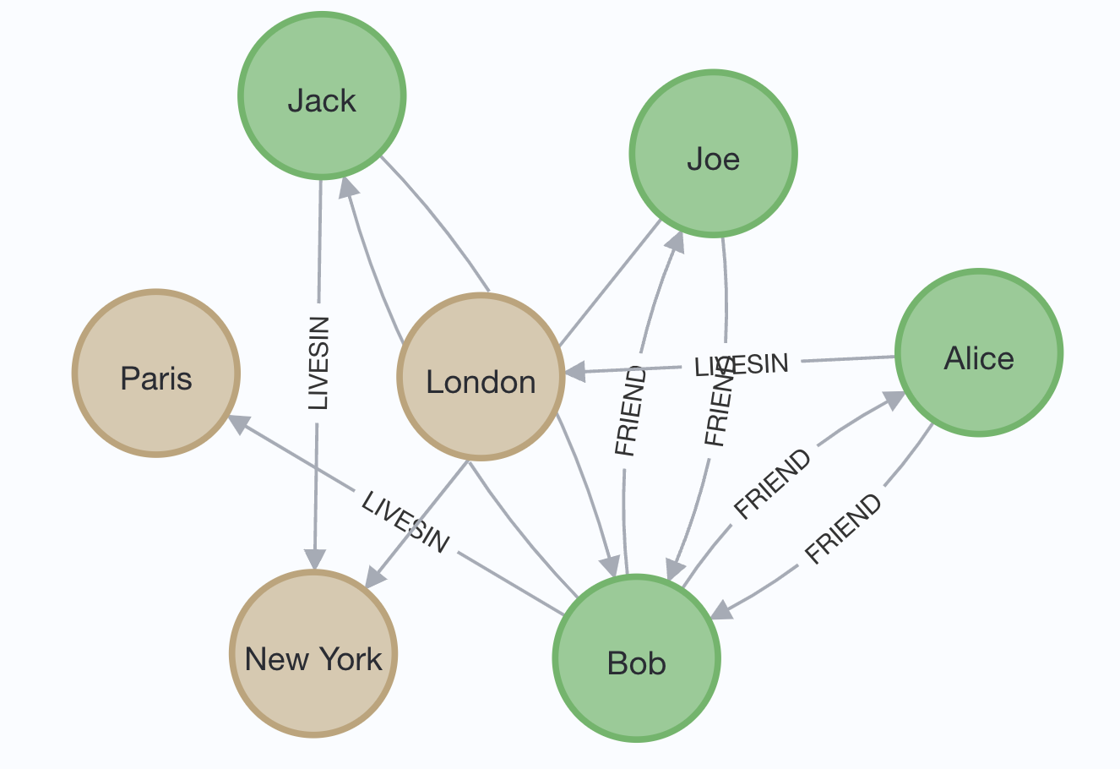
A Simple Example (Run Jupyter Notebook)
Run Graph_OpenAI.ipynb
With Friends.txt in the data folder
Bob is Alice's friend since 2020
Alice is Bob's friend since 2020
There is a place called Paris
Bob lives in Paris since 2018
Bob is 25 years old
There is a place called London
Alice lives London
Alice 30 years old
Bob is Joe's friend
Joe is Bob's friend
There is a place called New York
Joe lives in New York
Joe is 28 years old
Bob is Jack's friend
Jack is Bob's friend
Jack lives in New York
Jack is 18 years old

Slide 18
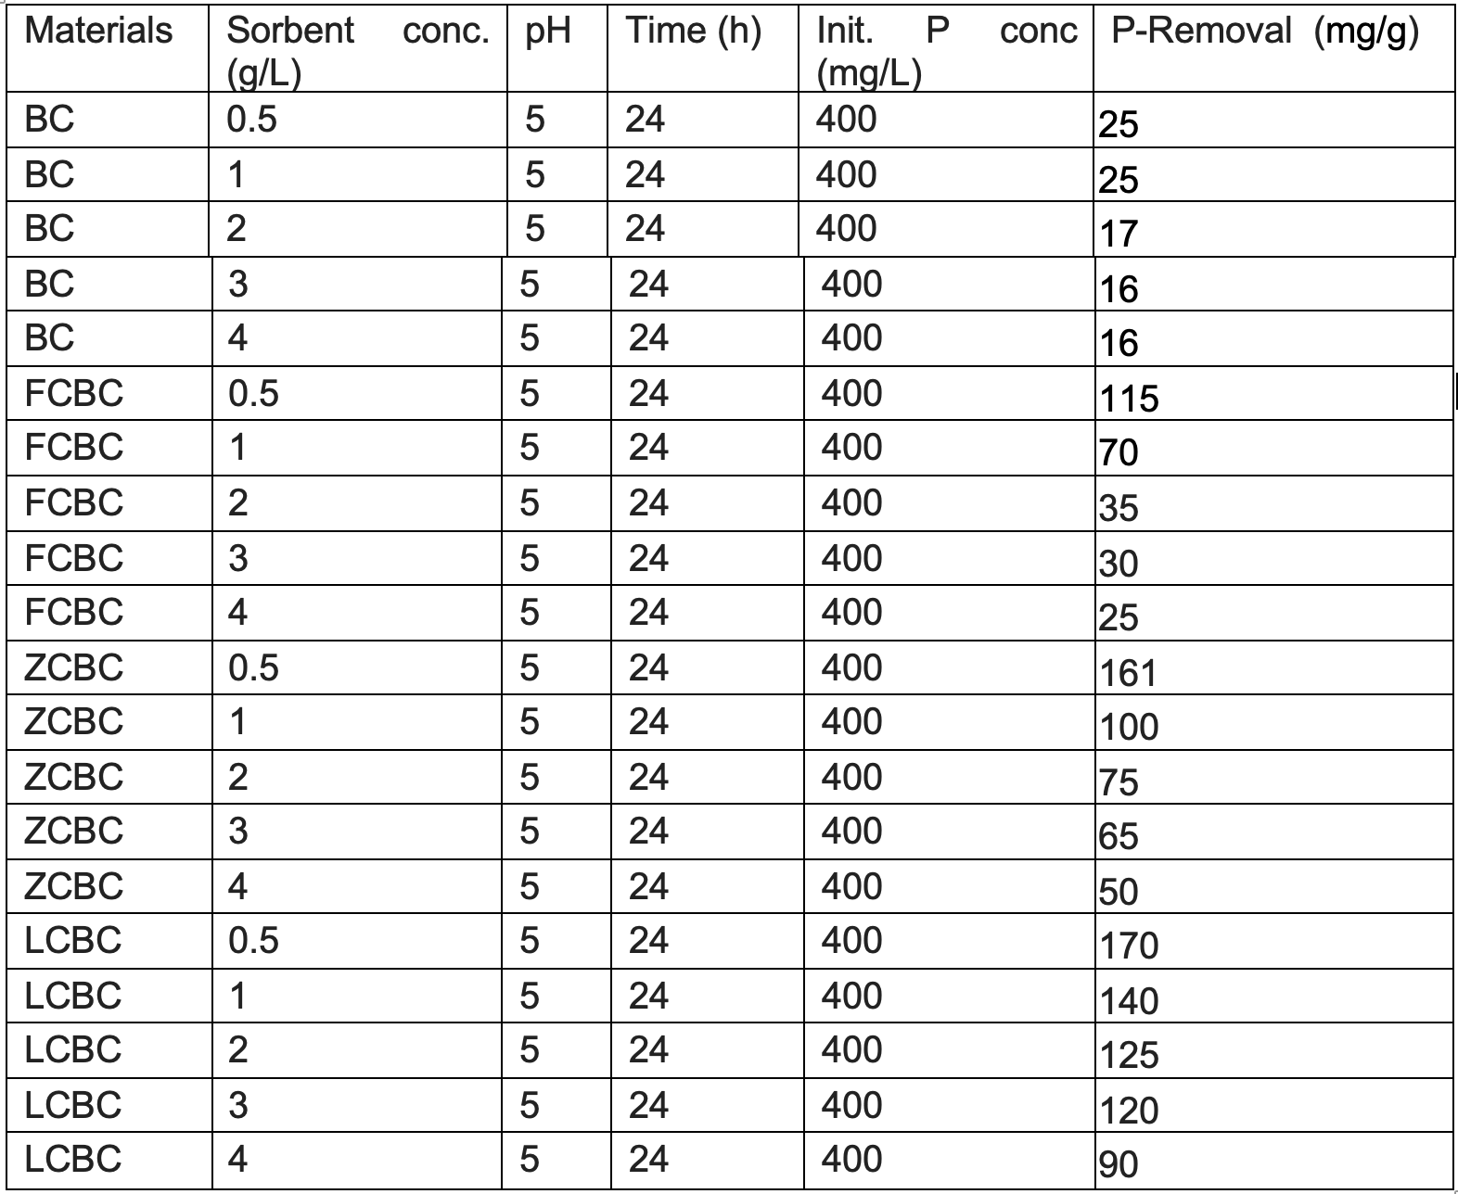
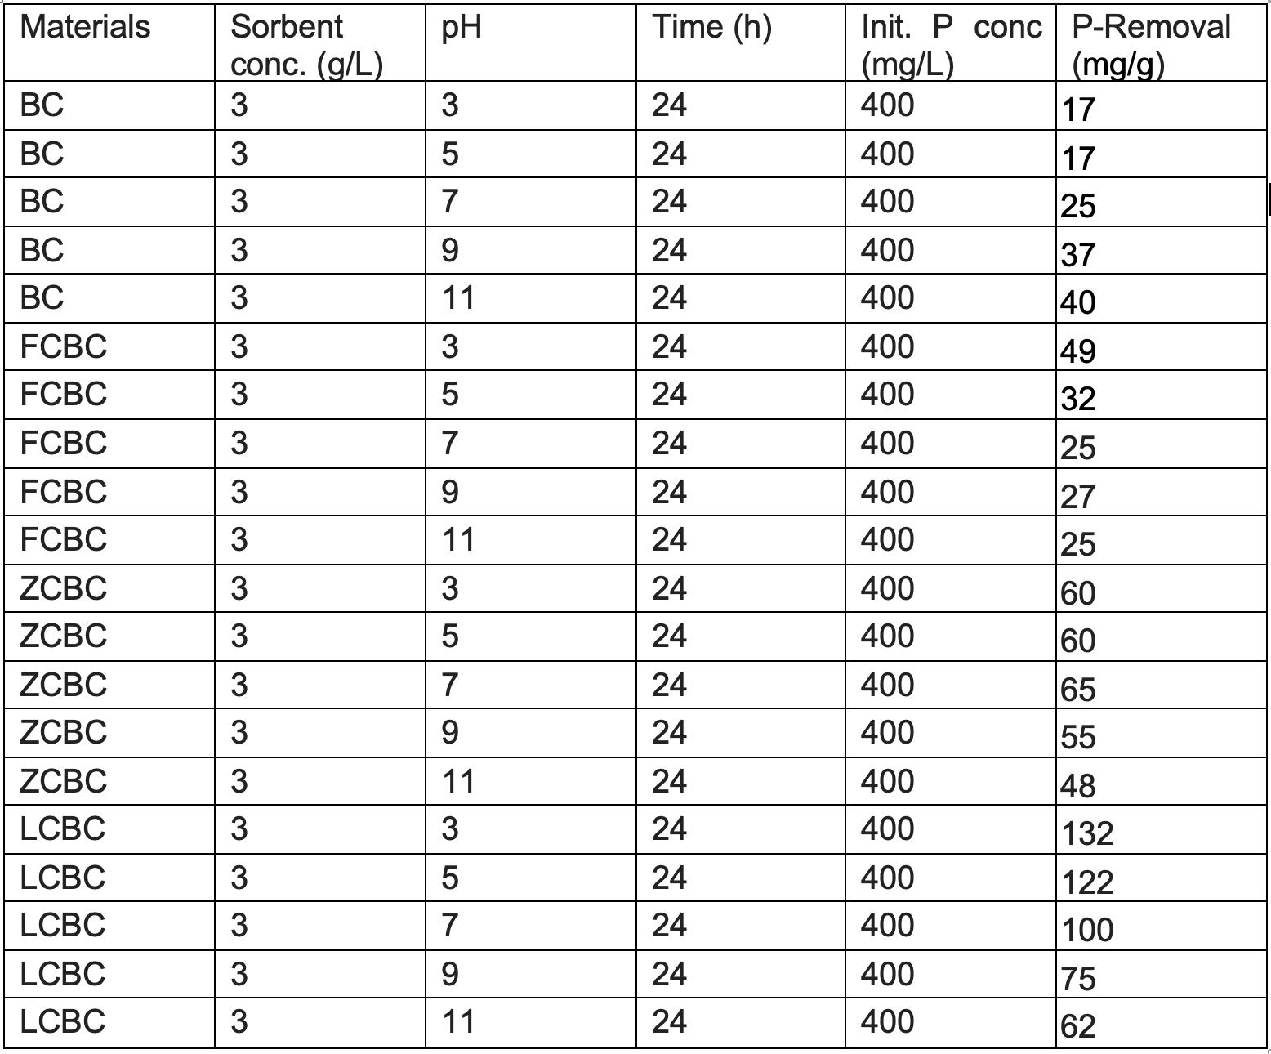
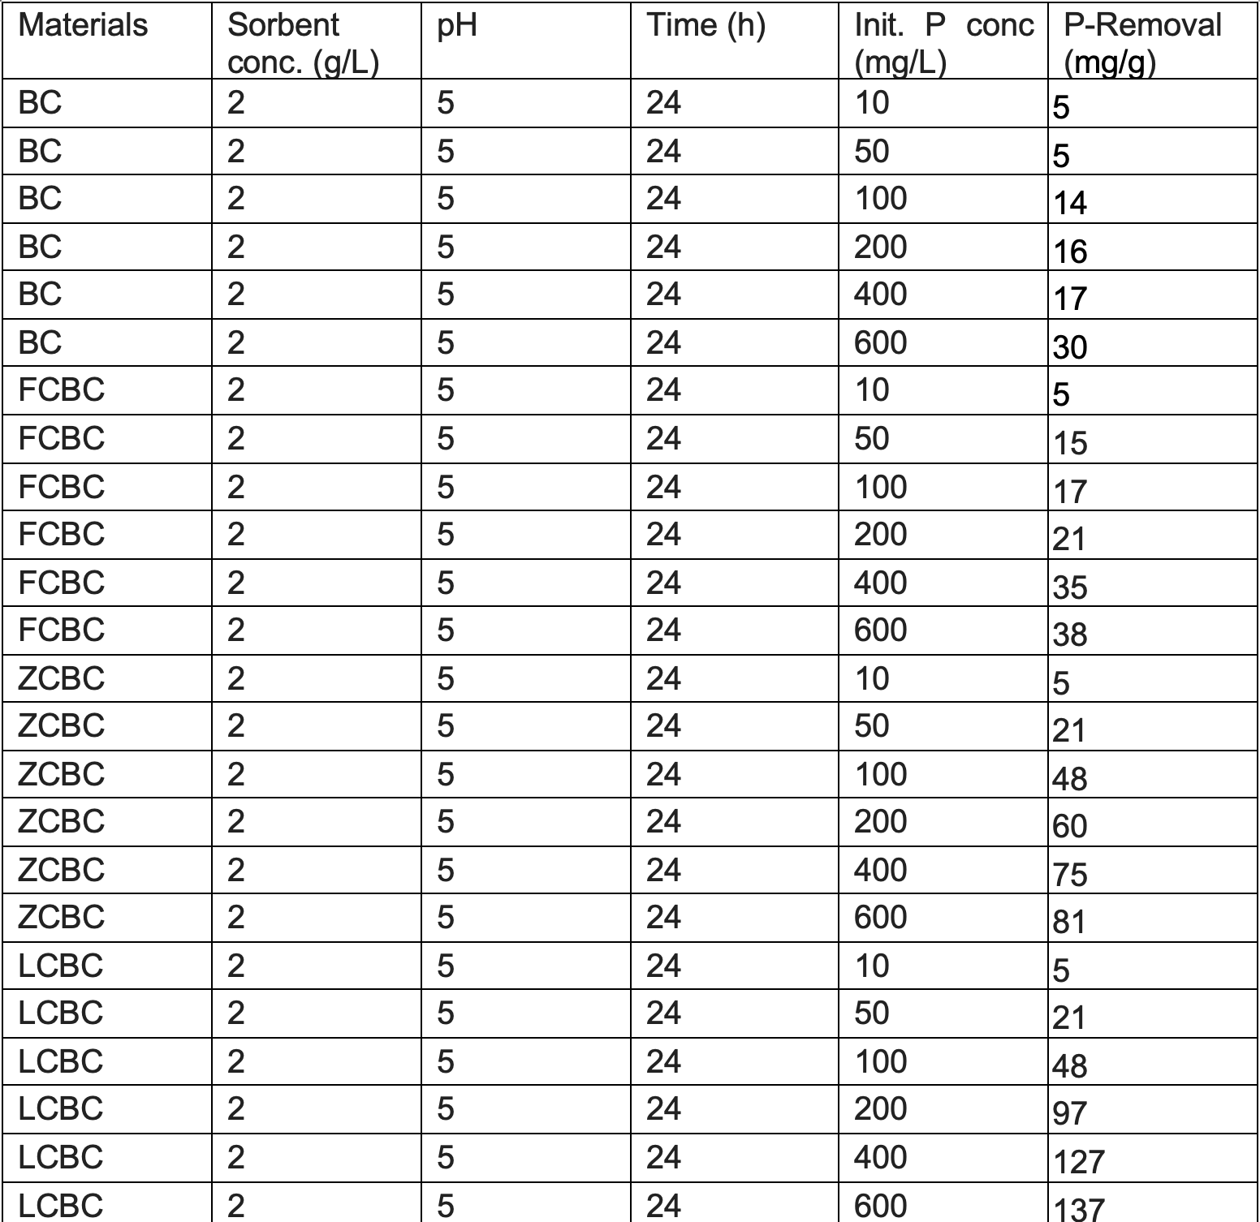
Another Example
Experimental data of 4 materials’ phosphorus absorption capacity:

Slide 19
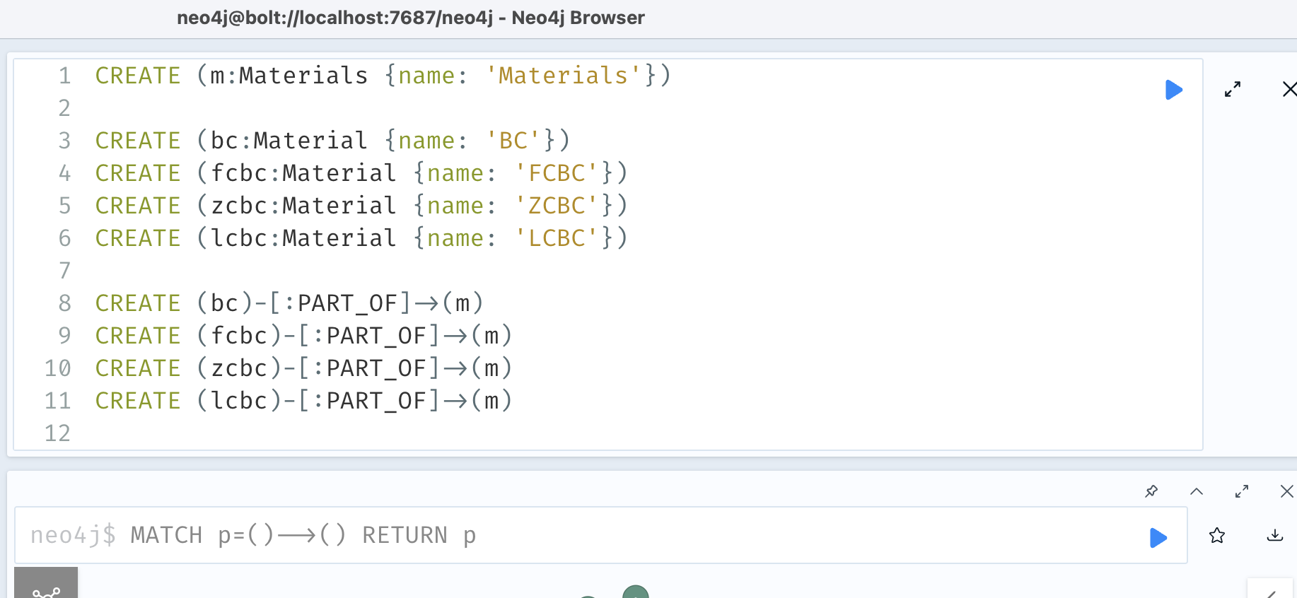
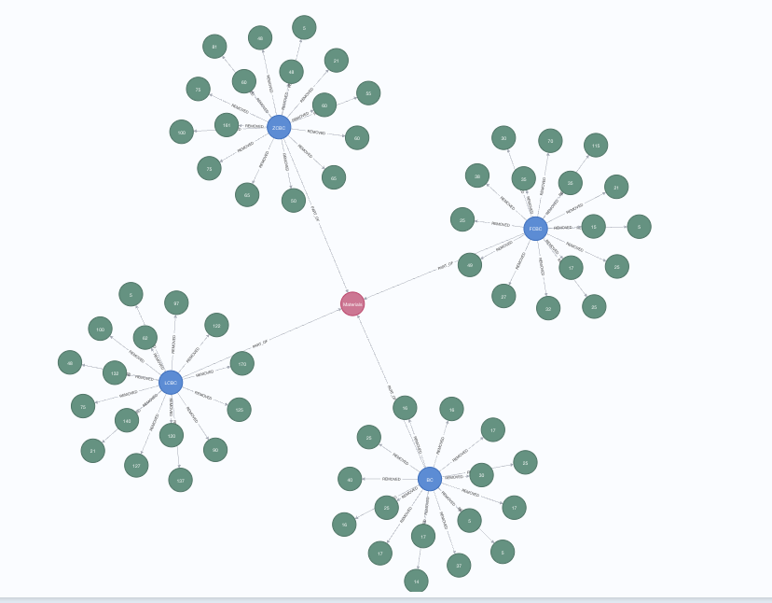
Import to Neo4j
CREATE (m:Materials {name: 'Materials'})
CREATE (bc:Material {name: 'BC'})
CREATE (fcbc:Material {name: 'FCBC'})
CREATE (zcbc:Material {name: 'ZCBC'})
CREATE (lcbc:Material {name: 'LCBC'})
CREATE (bc)-[:PART_OF]->(m)
CREATE (fcbc)-[:PART_OF]->(m)
CREATE (zcbc)-[:PART_OF]->(m)
CREATE (lcbc)-[:PART_OF]->(m)
CREATE (p1:PRemoval {PRemoval: 17, PRemoval_unit: 'mg/g'})
CREATE (bc)-[:REMOVED {
sorbent_conc: 3,
sorbent_conc_unit: 'g/L',
pH: 3,
time: 24,
time_unit: 'h',
initial_P_conc: 400,
initial_P_conc_unit: 'mg/L'
}]->(p1)
CREATE (p2:PRemoval {PRemoval: 17, PRemoval_unit: 'mg/g'})
CREATE (bc)-[:REMOVED {
sorbent_conc: 3,
sorbent_conc_unit: 'g/L',
pH: 5,
time: 24,
time_unit: 'h',
initial_P_conc: 400,
initial_P_conc_unit: 'mg/L'
}]->(p2)
CREATE (p3:PRemoval {PRemoval: 25, PRemoval_unit: 'mg/g'})
CREATE (bc)-[:REMOVED {
sorbent_conc: 3,
sorbent_conc_unit: 'g/L',
pH: 7,
time: 24,
time_unit: 'h',
initial_P_conc: 400,
initial_P_conc_unit: 'mg/L'
}]->(p3)
CREATE (p4:PRemoval {PRemoval: 37, PRemoval_unit: 'mg/g'})
CREATE (bc)-[:REMOVED {
sorbent_conc: 3,
sorbent_conc_unit: 'g/L',
pH: 9,
time: 24,
time_unit: 'h',
initial_P_conc: 400,
initial_P_conc_unit: 'mg/L'
}]->(p4)
CREATE (p5:PRemoval {PRemoval: 40, PRemoval_unit: 'mg/g'})
CREATE (bc)-[:REMOVED {
sorbent_conc: 3,
sorbent_conc_unit: 'g/L',
pH: 11,
time: 24,
time_unit: 'h',
initial_P_conc: 400,
initial_P_conc_unit: 'mg/L'
}]->(p5)
CREATE (p6:PRemoval {PRemoval: 49, PRemoval_unit: 'mg/g'})
CREATE (fcbc)-[:REMOVED {
sorbent_conc: 3,
sorbent_conc_unit: 'g/L',
pH: 3,
time: 24,
time_unit: 'h',
initial_P_conc: 400,
initial_P_conc_unit: 'mg/L'
}]->(p6)
CREATE (p7:PRemoval {PRemoval: 32, PRemoval_unit: 'mg/g'})
CREATE (fcbc)-[:REMOVED {
sorbent_conc: 3,
sorbent_conc_unit: 'g/L',
pH: 5,
time: 24,
time_unit: 'h',
initial_P_conc: 400,
initial_P_conc_unit: 'mg/L'
}]->(p7)
CREATE (p8:PRemoval {PRemoval: 25, PRemoval_unit: 'mg/g'})
CREATE (fcbc)-[:REMOVED {
sorbent_conc: 3,
sorbent_conc_unit: 'g/L',
pH: 7,
time: 24,
time_unit: 'h',
initial_P_conc: 400,
initial_P_conc_unit: 'mg/L'
}]->(p8)
CREATE (p9:PRemoval {PRemoval: 27, PRemoval_unit: 'mg/g'})
CREATE (fcbc)-[:REMOVED {
sorbent_conc: 3,
sorbent_conc_unit: 'g/L',
pH: 9,
time: 24,
time_unit: 'h',
initial_P_conc: 400,
initial_P_conc_unit: 'mg/L'
}]->(p9)
CREATE (p10:PRemoval {PRemoval: 25, PRemoval_unit: 'mg/g'})
CREATE (fcbc)-[:REMOVED {
sorbent_conc: 3,
sorbent_conc_unit: 'g/L',
pH: 11,
time: 24,
time_unit: 'h',
initial_P_conc: 400,
initial_P_conc_unit: 'mg/L'
}]->(p10)
CREATE (p11:PRemoval {PRemoval: 60, PRemoval_unit: 'mg/g'})
CREATE (zcbc)-[:REMOVED {
sorbent_conc: 3,
sorbent_conc_unit: 'g/L',
pH: 3,
time: 24,
time_unit: 'h',
initial_P_conc: 400,
initial_P_conc_unit: 'mg/L'
}]->(p11)
CREATE (p12:PRemoval {PRemoval: 60, PRemoval_unit: 'mg/g'})
CREATE (zcbc)-[:REMOVED {
sorbent_conc: 3,
sorbent_conc_unit: 'g/L',
pH: 5,
time: 24,
time_unit: 'h',
initial_P_conc: 400,
initial_P_conc_unit: 'mg/L'
}]->(p12)
CREATE (p13:PRemoval {PRemoval: 65, PRemoval_unit: 'mg/g'})
CREATE (zcbc)-[:REMOVED {
sorbent_conc: 3,
sorbent_conc_unit: 'g/L',
pH: 7,
time: 24,
time_unit: 'h',
initial_P_conc: 400,
initial_P_conc_unit: 'mg/L'
}]->(p13)
CREATE (p14:PRemoval {PRemoval: 55, PRemoval_unit: 'mg/g'})
CREATE (zcbc)-[:REMOVED {
sorbent_conc: 3,
sorbent_conc_unit: 'g/L',
pH: 9,
time: 24,
time_unit: 'h',
initial_P_conc: 400,
initial_P_conc_unit: 'mg/L'
}]->(p14)
CREATE (p15:PRemoval {PRemoval: 48, PRemoval_unit: 'mg/g'})
CREATE (zcbc)-[:REMOVED {
sorbent_conc: 3,
sorbent_conc_unit: 'g/L',
pH: 11,
time: 24,
time_unit: 'h',
initial_P_conc: 400,
initial_P_conc_unit: 'mg/L'
}]->(p15)
CREATE (p16:PRemoval {PRemoval: 132, PRemoval_unit: 'mg/g'})
CREATE (lcbc)-[:REMOVED {
sorbent_conc: 3,
sorbent_conc_unit: 'g/L',
pH: 3,
time: 24,
time_unit: 'h',
initial_P_conc: 400,
initial_P_conc_unit: 'mg/L'
}]->(p16)
CREATE (p17:PRemoval {PRemoval: 122, PRemoval_unit: 'mg/g'})
CREATE (lcbc)-[:REMOVED {
sorbent_conc: 3,
sorbent_conc_unit: 'g/L',
pH: 5,
time: 24,
time_unit: 'h',
initial_P_conc: 400,
initial_P_conc_unit: 'mg/L'
}]->(p17)
CREATE (p18:PRemoval {PRemoval: 100, PRemoval_unit: 'mg/g'})
CREATE (lcbc)-[:REMOVED {
sorbent_conc: 3,
sorbent_conc_unit: 'g/L',
pH: 7,
time: 24,
time_unit: 'h',
initial_P_conc: 400,
initial_P_conc_unit: 'mg/L'
}]->(p18)
CREATE (p19:PRemoval {PRemoval: 75, PRemoval_unit: 'mg/g'})
CREATE (lcbc)-[:REMOVED {
sorbent_conc: 3,
sorbent_conc_unit: 'g/L',
pH: 9,
time: 24,
time_unit: 'h',
initial_P_conc: 400,
initial_P_conc_unit: 'mg/L'
}]->(p19)
CREATE (p20:PRemoval {PRemoval: 62, PRemoval_unit: 'mg/g'})
CREATE (lcbc)-[:REMOVED {
sorbent_conc: 3,
sorbent_conc_unit: 'g/L',
pH: 11,
time: 24,
time_unit: 'h',
initial_P_conc: 400,
initial_P_conc_unit: 'mg/L'
}]->(p20)
CREATE (p21:PRemoval {PRemoval: 5, PRemoval_unit: 'mg/g'})
CREATE (bc)-[:REMOVED {
sorbent_conc: 2,
sorbent_conc_unit: 'g/L',
pH: 5,
time: 24,
time_unit: 'h',
initial_P_conc: 10,
initial_P_conc_unit: 'mg/L'
}]->(p21)
CREATE (p22:PRemoval {PRemoval: 5, PRemoval_unit: 'mg/g'})
CREATE (bc)-[:REMOVED {
sorbent_conc: 2,
sorbent_conc_unit: 'g/L',
pH: 5,
time: 24,
time_unit: 'h',
initial_P_conc: 50,
initial_P_conc_unit: 'mg/L'
}]->(p22)
CREATE (p23:PRemoval {PRemoval: 14, PRemoval_unit: 'mg/g'})
CREATE (bc)-[:REMOVED {
sorbent_conc: 2,
sorbent_conc_unit: 'g/L',
pH: 5,
time: 24,
time_unit: 'h',
initial_P_conc: 100,
initial_P_conc_unit: 'mg/L'
}]->(p23)
CREATE (p24:PRemoval {PRemoval: 16, PRemoval_unit: 'mg/g'})
CREATE (bc)-[:REMOVED {
sorbent_conc: 2,
sorbent_conc_unit: 'g/L',
pH: 5,
time: 24,
time_unit: 'h',
initial_P_conc: 200,
initial_P_conc_unit: 'mg/L'
}]->(p24)
CREATE (p25:PRemoval {PRemoval: 17, PRemoval_unit: 'mg/g'})
CREATE (bc)-[:REMOVED {
sorbent_conc: 2,
sorbent_conc_unit: 'g/L',
pH: 5,
time: 24,
time_unit: 'h',
initial_P_conc: 400,
initial_P_conc_unit: 'mg/L'
}]->(p25)
CREATE (p26:PRemoval {PRemoval: 30, PRemoval_unit: 'mg/g'})
CREATE (bc)-[:REMOVED {
sorbent_conc: 2,
sorbent_conc_unit: 'g/L',
pH: 5,
time: 24,
time_unit: 'h',
initial_P_conc: 600,
initial_P_conc_unit: 'mg/L'
}]->(p26)
CREATE (p27:PRemoval {PRemoval: 5, PRemoval_unit: 'mg/g'})
CREATE (fcbc)-[:REMOVED {
sorbent_conc: 2,
sorbent_conc_unit: 'g/L',
pH: 5,
time: 24,
time_unit: 'h',
initial_P_conc: 10,
initial_P_conc_unit: 'mg/L'
}]->(p27)
CREATE (p28:PRemoval {PRemoval: 15, PRemoval_unit: 'mg/g'})
CREATE (fcbc)-[:REMOVED {
sorbent_conc: 2,
sorbent_conc_unit: 'g/L',
pH: 5,
time: 24,
time_unit: 'h',
initial_P_conc: 50,
initial_P_conc_unit: 'mg/L'
}]->(p28)
CREATE (p29:PRemoval {PRemoval: 17, PRemoval_unit: 'mg/g'})
CREATE (fcbc)-[:REMOVED {
sorbent_conc: 2,
sorbent_conc_unit: 'g/L',
pH: 5,
time: 24,
time_unit: 'h',
initial_P_conc: 100,
initial_P_conc_unit: 'mg/L'
}]->(p29)
CREATE (p30:PRemoval {PRemoval: 21, PRemoval_unit: 'mg/g'})
CREATE (fcbc)-[:REMOVED {
sorbent_conc: 2,
sorbent_conc_unit: 'g/L',
pH: 5,
time: 24,
time_unit: 'h',
initial_P_conc: 200,
initial_P_conc_unit: 'mg/L'
}]->(p30)
CREATE (p31:PRemoval {PRemoval: 35, PRemoval_unit: 'mg/g'})
CREATE (fcbc)-[:REMOVED {
sorbent_conc: 2,
sorbent_conc_unit: 'g/L',
pH: 5,
time: 24,
time_unit: 'h',
initial_P_conc: 400,
initial_P_conc_unit: 'mg/L'
}]->(p31)
CREATE (p32:PRemoval {PRemoval: 38, PRemoval_unit: 'mg/g'})
CREATE (fcbc)-[:REMOVED {
sorbent_conc: 2,
sorbent_conc_unit: 'g/L',
pH: 5,
time: 24,
time_unit: 'h',
initial_P_conc: 600,
initial_P_conc_unit: 'mg/L'
}]->(p32)
CREATE (p33:PRemoval {PRemoval: 5, PRemoval_unit: 'mg/g'})
CREATE (zcbc)-[:REMOVED {
sorbent_conc: 2,
sorbent_conc_unit: 'g/L',
pH: 5,
time: 24,
time_unit: 'h',
initial_P_conc: 10,
initial_P_conc_unit: 'mg/L'
}]->(p33)
CREATE (p34:PRemoval {PRemoval: 21, PRemoval_unit: 'mg/g'})
CREATE (zcbc)-[:REMOVED {
sorbent_conc: 2,
sorbent_conc_unit: 'g/L',
pH: 5,
time: 24,
time_unit: 'h',
initial_P_conc: 50,
initial_P_conc_unit: 'mg/L'
}]->(p34)
CREATE (p35:PRemoval {PRemoval: 48, PRemoval_unit: 'mg/g'})
CREATE (zcbc)-[:REMOVED {
sorbent_conc: 2,
sorbent_conc_unit: 'g/L',
pH: 5,
time: 24,
time_unit: 'h',
initial_P_conc: 100,
initial_P_conc_unit: 'mg/L'
}]->(p35)
CREATE (p36:PRemoval {PRemoval: 60, PRemoval_unit: 'mg/g'})
CREATE (zcbc)-[:REMOVED {
sorbent_conc: 2,
sorbent_conc_unit: 'g/L',
pH: 5,
time: 24,
time_unit: 'h',
initial_P_conc: 200,
initial_P_conc_unit: 'mg/L'
}]->(p36)
CREATE (p37:PRemoval {PRemoval: 75, PRemoval_unit: 'mg/g'})
CREATE (zcbc)-[:REMOVED {
sorbent_conc: 2,
sorbent_conc_unit: 'g/L',
pH: 5,
time: 24,
time_unit: 'h',
initial_P_conc: 400,
initial_P_conc_unit: 'mg/L'
}]->(p37)
CREATE (p38:PRemoval {PRemoval: 81, PRemoval_unit: 'mg/g'})
CREATE (zcbc)-[:REMOVED {
sorbent_conc: 2,
sorbent_conc_unit: 'g/L',
pH: 5,
time: 24,
time_unit: 'h',
initial_P_conc: 600,
initial_P_conc_unit: 'mg/L'
}]->(p38)
CREATE (p39:PRemoval {PRemoval: 5, PRemoval_unit: 'mg/g'})
CREATE (lcbc)-[:REMOVED {
sorbent_conc: 2,
sorbent_conc_unit: 'g/L',
pH: 5,
time: 24,
time_unit: 'h',
initial_P_conc: 10,
initial_P_conc_unit: 'mg/L'
}]->(p39)
CREATE (p40:PRemoval {PRemoval: 21, PRemoval_unit: 'mg/g'})
CREATE (lcbc)-[:REMOVED {
sorbent_conc: 2,
sorbent_conc_unit: 'g/L',
pH: 5,
time: 24,
time_unit: 'h',
initial_P_conc: 50,
initial_P_conc_unit: 'mg/L'
}]->(p40)
CREATE (p41:PRemoval {PRemoval: 48, PRemoval_unit: 'mg/g'})
CREATE (lcbc)-[:REMOVED {
sorbent_conc: 2,
sorbent_conc_unit: 'g/L',
pH: 5,
time: 24,
time_unit: 'h',
initial_P_conc: 100,
initial_P_conc_unit: 'mg/L'
}]->(p41)
CREATE (p42:PRemoval {PRemoval: 97, PRemoval_unit: 'mg/g'})
CREATE (lcbc)-[:REMOVED {
sorbent_conc: 2,
sorbent_conc_unit: 'g/L',
pH: 5,
time: 24,
time_unit: 'h',
initial_P_conc: 200,
initial_P_conc_unit: 'mg/L'
}]->(p42)
CREATE (p43:PRemoval {PRemoval: 127, PRemoval_unit: 'mg/g'})
CREATE (lcbc)-[:REMOVED {
sorbent_conc: 2,
sorbent_conc_unit: 'g/L',
pH: 5,
time: 24,
time_unit: 'h',
initial_P_conc: 400,
initial_P_conc_unit: 'mg/L'
}]->(p43)
CREATE (p44:PRemoval {PRemoval: 137, PRemoval_unit: 'mg/g'})
CREATE (lcbc)-[:REMOVED {
sorbent_conc: 2,
sorbent_conc_unit: 'g/L',
pH: 5,
time: 24,
time_unit: 'h',
initial_P_conc: 600,
initial_P_conc_unit: 'mg/L'
}]->(p44)
CREATE (p45:PRemoval {PRemoval: 25, PRemoval_unit: 'mg/g'})
CREATE (bc)-[:REMOVED {
sorbent_conc: 0.5,
sorbent_conc_unit: 'g/L',
pH: 5,
time: 24,
time_unit: 'h',
initial_P_conc: 400,
initial_P_conc_unit: 'mg/L'
}]->(p45)
CREATE (p46:PRemoval {PRemoval: 25, PRemoval_unit: 'mg/g'})
CREATE (bc)-[:REMOVED {
sorbent_conc: 1,
sorbent_conc_unit: 'g/L',
pH: 5,
time: 24,
time_unit: 'h',
initial_P_conc: 400,
initial_P_conc_unit: 'mg/L'
}]->(p46)
CREATE (p47:PRemoval {PRemoval: 17, PRemoval_unit: 'mg/g'})
CREATE (bc)-[:REMOVED {
sorbent_conc: 2,
sorbent_conc_unit: 'g/L',
pH: 5,
time: 24,
time_unit: 'h',
initial_P_conc: 400,
initial_P_conc_unit: 'mg/L'
}]->(p47)
CREATE (p48:PRemoval {PRemoval: 16, PRemoval_unit: 'mg/g'})
CREATE (bc)-[:REMOVED {
sorbent_conc: 3,
sorbent_conc_unit: 'g/L',
pH: 5,
time: 24,
time_unit: 'h',
initial_P_conc: 400,
initial_P_conc_unit: 'mg/L'
}]->(p48)
CREATE (p49:PRemoval {PRemoval: 16, PRemoval_unit: 'mg/g'})
CREATE (bc)-[:REMOVED {
sorbent_conc: 4,
sorbent_conc_unit: 'g/L',
pH: 5,
time: 24,
time_unit: 'h',
initial_P_conc: 400,
initial_P_conc_unit: 'mg/L'
}]->(p49)
CREATE (p50:PRemoval {PRemoval: 115, PRemoval_unit: 'mg/g'})
CREATE (fcbc)-[:REMOVED {
sorbent_conc: 0.5,
sorbent_conc_unit: 'g/L',
pH: 5,
time: 24,
time_unit: 'h',
initial_P_conc: 400,
initial_P_conc_unit: 'mg/L'
}]->(p50)
CREATE (p51:PRemoval {PRemoval: 70, PRemoval_unit: 'mg/g'})
CREATE (fcbc)-[:REMOVED {
sorbent_conc: 1,
sorbent_conc_unit: 'g/L',
pH: 5,
time: 24,
time_unit: 'h',
initial_P_conc: 400,
initial_P_conc_unit: 'mg/L'
}]->(p51)
CREATE (p52:PRemoval {PRemoval: 35, PRemoval_unit: 'mg/g'})
CREATE (fcbc)-[:REMOVED {
sorbent_conc: 2,
sorbent_conc_unit: 'g/L',
pH: 5,
time: 24,
time_unit: 'h',
initial_P_conc: 400,
initial_P_conc_unit: 'mg/L'
}]->(p52)
CREATE (p53:PRemoval {PRemoval: 30, PRemoval_unit: 'mg/g'})
CREATE (fcbc)-[:REMOVED {
sorbent_conc: 3,
sorbent_conc_unit: 'g/L',
pH: 5,
time: 24,
time_unit: 'h',
initial_P_conc: 400,
initial_P_conc_unit: 'mg/L'
}]->(p53)
CREATE (p54:PRemoval {PRemoval: 25, PRemoval_unit: 'mg/g'})
CREATE (fcbc)-[:REMOVED {
sorbent_conc: 4,
sorbent_conc_unit: 'g/L',
pH: 5,
time: 24,
time_unit: 'h',
initial_P_conc: 400,
initial_P_conc_unit: 'mg/L'
}]->(p54)
CREATE (p55:PRemoval {PRemoval: 161, PRemoval_unit: 'mg/g'})
CREATE (zcbc)-[:REMOVED {
sorbent_conc: 0.5,
sorbent_conc_unit: 'g/L',
pH: 5,
time: 24,
time_unit: 'h',
initial_P_conc: 400,
initial_P_conc_unit: 'mg/L'
}]->(p55)
CREATE (p56:PRemoval {PRemoval: 100, PRemoval_unit: 'mg/g'})
CREATE (zcbc)-[:REMOVED {
sorbent_conc: 1,
sorbent_conc_unit: 'g/L',
pH: 5,
time: 24,
time_unit: 'h',
initial_P_conc: 400,
initial_P_conc_unit: 'mg/L'
}]->(p56)
CREATE (p57:PRemoval {PRemoval: 75, PRemoval_unit: 'mg/g'})
CREATE (zcbc)-[:REMOVED {
sorbent_conc: 2,
sorbent_conc_unit: 'g/L',
pH: 5,
time: 24,
time_unit: 'h',
initial_P_conc: 400,
initial_P_conc_unit: 'mg/L'
}]->(p57)
CREATE (p58:PRemoval {PRemoval: 65, PRemoval_unit: 'mg/g'})
CREATE (zcbc)-[:REMOVED {
sorbent_conc: 3,
sorbent_conc_unit: 'g/L',
pH: 5,
time: 24,
time_unit: 'h',
initial_P_conc: 400,
initial_P_conc_unit: 'mg/L'
}]->(p58)
CREATE (p59:PRemoval {PRemoval: 50, PRemoval_unit: 'mg/g'})
CREATE (zcbc)-[:REMOVED {
sorbent_conc: 4,
sorbent_conc_unit: 'g/L',
pH: 5,
time: 24,
time_unit: 'h',
initial_P_conc: 400,
initial_P_conc_unit: 'mg/L'
}]->(p59)
CREATE (p60:PRemoval {PRemoval: 170, PRemoval_unit: 'mg/g'})
CREATE (lcbc)-[:REMOVED {
sorbent_conc: 0.5,
sorbent_conc_unit: 'g/L',
pH: 5,
time: 24,
time_unit: 'h',
initial_P_conc: 400,
initial_P_conc_unit: 'mg/L'
}]->(p60)
CREATE (p61:PRemoval {PRemoval: 140, PRemoval_unit: 'mg/g'})
CREATE (lcbc)-[:REMOVED {
sorbent_conc: 1,
sorbent_conc_unit: 'g/L',
pH: 5,
time: 24,
time_unit: 'h',
initial_P_conc: 400,
initial_P_conc_unit: 'mg/L'
}]->(p61)
CREATE (p62:PRemoval {PRemoval: 125, PRemoval_unit: 'mg/g'})
CREATE (lcbc)-[:REMOVED {
sorbent_conc: 2,
sorbent_conc_unit: 'g/L',
pH: 5,
time: 24,
time_unit: 'h',
initial_P_conc: 400,
initial_P_conc_unit: 'mg/L'
}]->(p62)
CREATE (p63:PRemoval {PRemoval: 120, PRemoval_unit: 'mg/g'})
CREATE (lcbc)-[:REMOVED {
sorbent_conc: 3,
sorbent_conc_unit: 'g/L',
pH: 5,
time: 24,
time_unit: 'h',
initial_P_conc: 400,
initial_P_conc_unit: 'mg/L'
}]->(p63)
CREATE (p64:PRemoval {PRemoval: 90, PRemoval_unit: 'mg/g'})
CREATE (lcbc)-[:REMOVED {
sorbent_conc: 4,
sorbent_conc_unit: 'g/L',
pH: 5,
time: 24,
time_unit: 'h',
initial_P_conc: 400,
initial_P_conc_unit: 'mg/L'
}]->(p64)
Copy the Cypher code to
Neo4j Browser and execute
Neo4j Browser
Graph of the Data

Slide 20
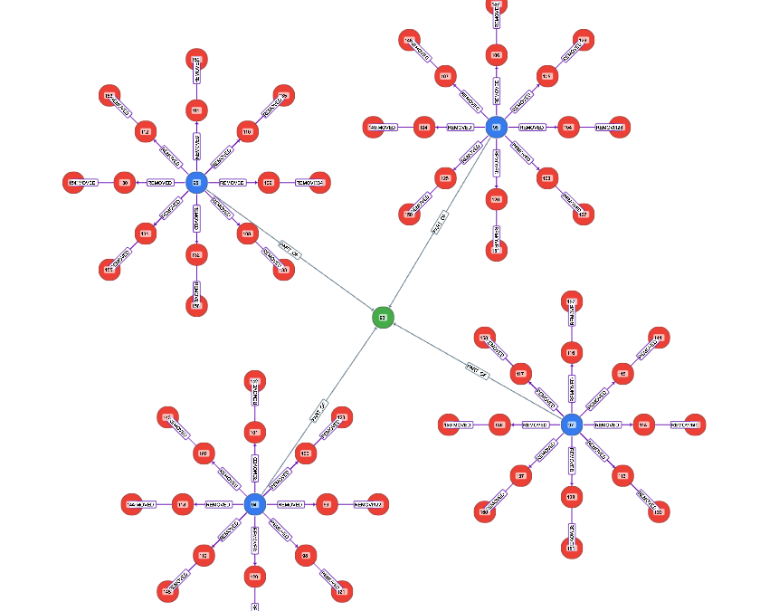
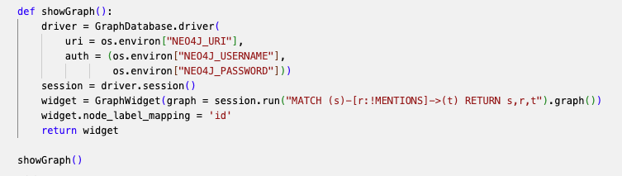
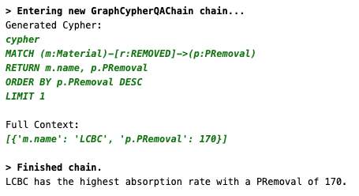
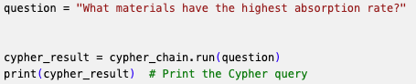
Back to Jupyter Notebook
Only execute showGraph block to check the graph
Ask questions:
Answer:
Only execute this block:

Slide 21





Run with Local LLM instead of OPENAI API
+

Slide 22
Advanced

Slide 23






Build a Web App for the Chatbot
Build a web-based AI-powered chatbot
+

Slide 24
Install Anaconda
Windows: https://docs.anaconda.com/anaconda/install/windows/
Mac: https://docs.anaconda.com/anaconda/install/mac-os/
Linux: https://docs.anaconda.com/anaconda/install/linux/
Anaconda is an open-source distribution of the Python and R programming languages for data science that simplifies package management and deployment.

Slide 25
Create Folders
Django is a free, open-source web framework that helps developers build websites quickly and efficiently.
Create a Folder LLM:
mkdir LLM
Change directory to LLM:
cd LLM
Create a folder Django_project:
mkdir Django_project
Change directory to Django_project :
cd Django_project
├── LLM
│ └── Django_project
└── environment.yml

Slide 26
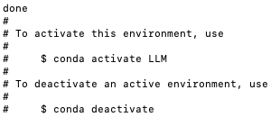
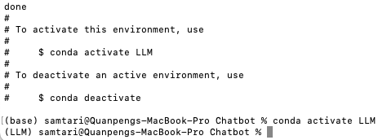
Create Virtual Environment from YML File
name: LLM
channels:
- defaults
dependencies:
- bzip2=1.0.8=h6c40b1e_6
- ca-certificates=2024.7.2=hecd8cb5_0
- expat=2.6.3=h6d0c2b6_0
- libcxx=14.0.6=h9765a3e_0
- libffi=3.4.4=hecd8cb5_1
- ncurses=6.4=hcec6c5f_0
- openssl=3.0.15=h46256e1_0
- pip=24.2=py312hecd8cb5_0
- python=3.12.3=hd58486a_1
- readline=8.2=hca72f7f_0
- setuptools=72.1.0=py312hecd8cb5_0
- sqlite=3.45.3=h6c40b1e_0
- tk=8.6.14=h4d00af3_0
- tzdata=2024a=h04d1e81_0
- wheel=0.44.0=py312hecd8cb5_0
- xz=5.4.6=h6c40b1e_1
- zlib=1.2.13=h4b97444_1
- pip:
- aiohappyeyeballs==2.4.0
- aiohttp==3.10.5
- aiosignal==1.3.1
- annotated-types==0.7.0
- anyio==4.4.0
- asgiref==3.8.1
- attrs==24.2.0
- certifi==2024.8.30
- charset-normalizer==3.3.2
- dataclasses-json==0.6.7
- django==5.1.1
- faiss-cpu==1.8.0.post1
- frozenlist==1.4.1
- greenlet==3.1.1
- h11==0.14.0
- httpcore==1.0.5
- httpx==0.27.2
- idna==3.10
- jsonpatch==1.33
- jsonpointer==3.0.0
- langchain==0.3.0
- langchain-community==0.3.0
- langchain-core==0.3.5
- langchain-text-splitters==0.3.0
- langsmith==0.1.125
- marshmallow==3.22.0
- multidict==6.1.0
- mypy-extensions==1.0.0
- numpy==1.26.4
- ollama==0.3.3
- orjson==3.10.7
- packaging==24.1
- pydantic==2.9.2
- pydantic-core==2.23.4
- pydantic-settings==2.5.2
- pymupdf==1.24.10
- pymupdfb==1.24.10
- python-dotenv==1.0.1
- pyyaml==6.0.2
- requests==2.32.3
- sniffio==1.3.1
- sqlalchemy==2.0.35
- sqlparse==0.5.1
- tenacity==8.5.0
- typing-extensions==4.12.2
- typing-inspect==0.9.0
- urllib3==2.2.3
- yarl==1.11.1
In terminal (Anaconda Prompt on Windows), type the command below and press ENTER key:
conda env create -f environment.yml
When the environment is created, you will see:
Activate the Virtual Environment:
conda activate LLM
If you see “(LLM)” at the beginning,
it means the LLM environment is activated:

Slide 27
Create Environment from requirements.txt File
In terminal (Anaconda Prompt on Windows), type the command below and press ENTER key:
conda create –-name LLM
Activate the Virtual Environment:
conda activate LLM
Install pip:
conda install pip
Install required packages:
pip install –r requirements.txt
If there is a “OpenSSL” related error when creating the environment:
This is due to .dll error
go to location where you've installed Anaconda Anaconda3>Library>bin. search and copy following dll files
libcrypto-1_1-x64.dll libssl-1_1-x64.dll
and paste to: Anaconda3>DLLs
then restart your terminal (or computer)
issue will get resolved.
aiohappyeyeballs==2.4.0
aiohttp==3.10.5
aiosignal==1.3.1
annotated-types==0.7.0
anyio==4.4.0
asgiref==3.8.1
attrs==24.2.0
certifi==2024.8.30
charset-normalizer==3.3.2
dataclasses-json==0.6.7
Django==5.1.1
faiss-cpu==1.8.0.post1
frozenlist==1.4.1
greenlet==3.1.1
h11==0.14.0
httpcore==1.0.5
httpx==0.27.2
idna==3.10
jsonpatch==1.33
jsonpointer==3.0.0
langchain==0.3.0
langchain-community==0.3.0
langchain-core==0.3.5
langchain-text-splitters==0.3.0
langsmith==0.1.125
marshmallow==3.22.0
multidict==6.1.0
mypy-extensions==1.0.0
numpy==1.26.4
ollama==0.3.3
orjson==3.10.7
packaging==24.1
pydantic==2.9.2
pydantic-settings==2.5.2
pydantic_core==2.23.4
PyMuPDF==1.24.10
PyMuPDFb==1.24.10
python-dotenv==1.0.1
PyYAML==6.0.2
requests==2.32.3
setuptools==72.1.0
sniffio==1.3.1
SQLAlchemy==2.0.35
sqlparse==0.5.1
tenacity==8.5.0
typing-inspect==0.9.0
typing_extensions==4.12.2
urllib3==2.2.3
wheel==0.44.0
yarl==1.11.1

Slide 28
Create a Django Project
├── LLM
│ └── Dj└── environment.yml
ango_project
In folder Django_project, create a project named ChatbotProject:
django-admin startproject ChatbotProject .
There will be some new files generated under the Django_project folder:
here
└── Django_project
├── ChatbotProject
│ ├── __init__.py
│ ├── asgi.py
│ ├── settings.py
│ ├── urls.py
│ └── wsgi.py
└── manage.py

Slide 29
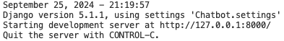
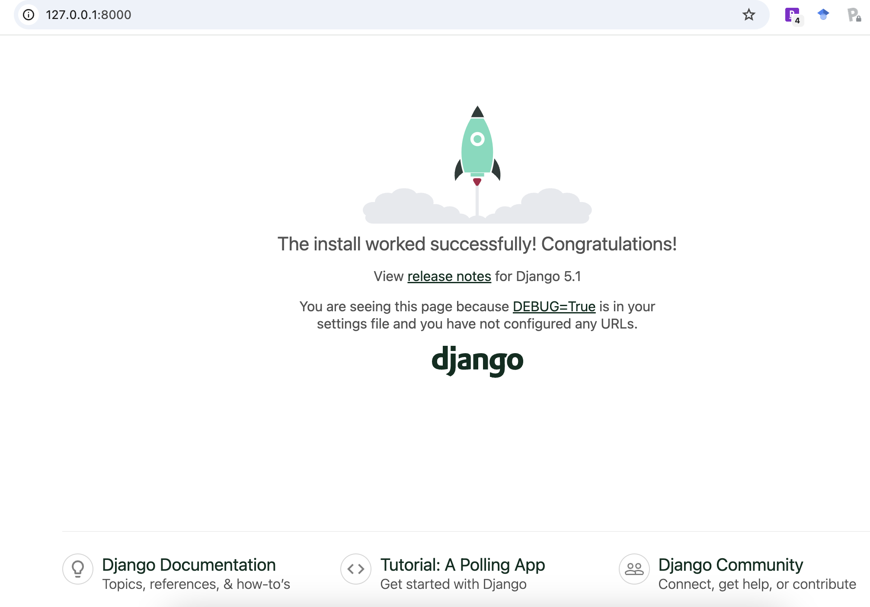
Verify if the Project Works:
└── Django_project
├── ChatbotProject
│ ├── __init__.py
│ ├── asgi.py
│ ├── settings.py
│ ├── urls.py
│ └── wsgi.py
└── manage.py
here
python manage.py runserver
You will see:
Access http://127.0.0.1:8000/ from a browser:
If you see this, congratulations! The project is built successfully!
If you want to exit:
CONTROL + Z (Windows)
COMMAND + Z (Mac)
But leaving it on is more convenient for the later development. Just open another terminal to continue. Don’t forget to activate environment.

Slide 30
Create an App: ChatbotApp
├── LLM
│ └── Django_project
└── environment.yml
python manage.py startapp ChatbotApp
here
There will be a new folder ChatbotApp and some files created:
├── ChatbotApp
│ ├── __init__.py
│ ├── admin.py
│ ├── apps.py
│ ├── migrations
│ │ └── __init__.py
│ ├── models.py
│ ├── tests.py
│ └── views.py
├── ChatbotProject
├── db.sqlite3
└── manage.py
Then, add ChatbotApp to settings
Edit settings.py file in ChatbotProject folder:
Add ‘ChatbotApp’, to INSTALLED_APPS list:
INSTALLED_APPS = [
'django.contrib.admin',
'django.contrib.auth',
'django.contrib.contenttypes',
'django.contrib.sessions',
'django.contrib.messages',
'django.contrib.staticfiles',
'ChatbotApp',
]

Slide 31
Create a Template for Webpage
Create a folder templetes under ChatbotApp for templates:
─── ChatbotApp
├── __init__.py
├── admin.py
├── apps.py
├── migrations
│ └── __init__.py
├── models.py
├── templates
│ └── chatbot.html
├── tests.py
└── views.py
Then create a file chatbot.html under templetes as a template:
Edit chatbot.html
<!DOCTYPE html>
<html>
<head>
<title>LLM Response</title>
</head>
<body style="height: 100%; margin: 0; display: flex; justify-content: center; align-items: center;">
<div style="text-align: center;">
<h1>My Chatbot</h1>
<p>{{ response }}</p>
</div>
</body>
</html>

Slide 32
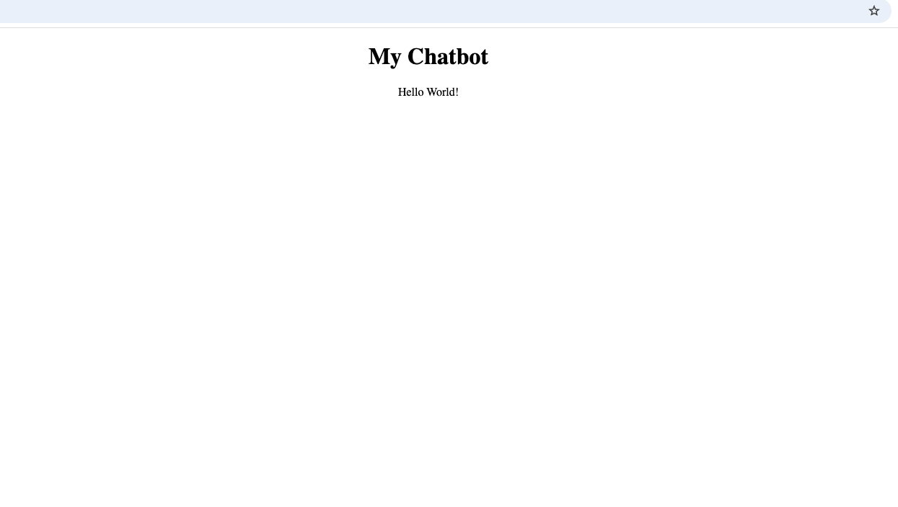
Print “Hello World!”
Create a function:
Edit the views.py file under ChatbotApp folder:
from django.shortcuts import render
def helloFunction(request):
response = {"response": "Hello World!"}
return render(request, 'chatbot.html', response)
Make Connections using urls.py
├── ChatbotProject
│ ├── asgi.py
│ ├── settings.py
│ ├── urls.py
│ └── wsgi.py
│
├── ChatbotApp
│ ├── admin.py
│ ├── apps.py
│ ├── migrations
│ ├── models.py
│ ├── templates
│ ├── tests.py
│ ├── urls.py
│ └── views.py
Edit the urls.py under the ChatbotProject folder:
from django.urls import path, include
urlpatterns = [
path('', include('ChatbotApp.urls')),
]
Connect Project and Apps
Create a urls.py under the ChatbotApp folder:
from django.urls import path
from . import views
urlpatterns = [
path('', views.helloFunction, name='helloFunction'),
]
Connect App and Functions

Slide 33
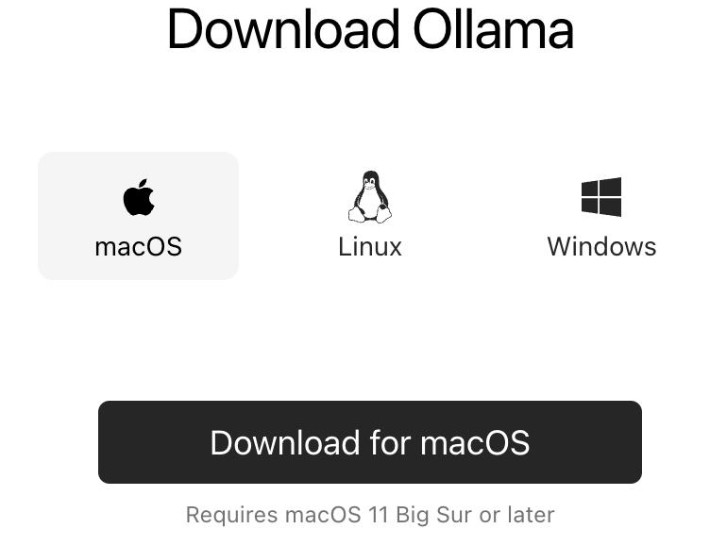
Install Ollama
https://ollama.com/download
might need to open a new terminal

Slide 34
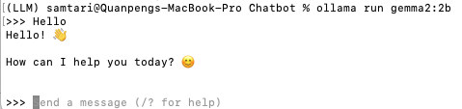
Install a Large Language Model
ollama pull gemma2:2b
ollama run gemma2:2b

Slide 35
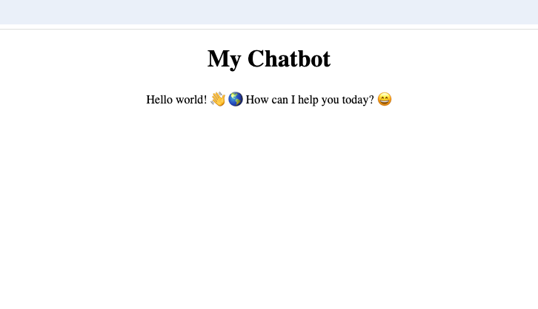
First LLM Output
Edit the views.py file under ChatbotApp folder:
from django.shortcuts import render
import ollama
LLM_Model = 'gemma2:2b'
def LLM(prompt):
response = ollama.chat(model=LLM_Model, messages=[{'role': 'user', 'content': prompt}])
return response['message']['content']
def helloFunction(request):
response = LLM("Hello world!")
response = {"response": response}
return render(request, 'chatbot.html', response)

Slide 36
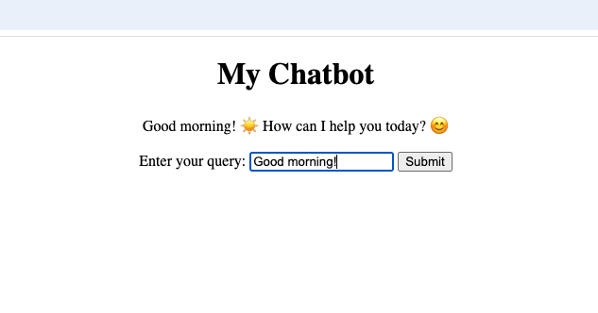
Interact with Chatbot
Edit the views.py file under ChatbotApp folder:
from django.shortcuts import render
import ollama
LLM_Model = 'gemma2:2b'
def LLM(prompt):
response = ollama.chat(model=LLM_Model, messages=[{'role': 'user', 'content': prompt}])
return response['message']['content']
def helloFunction(request):
userInput = request.GET.get('userInput')
response = LLM(userInput)
response = {"response": response}
return render(request, 'chatbot.html', response)
Edit the chatbot.html file under templates folder:
<!DOCTYPE html>
<html>
<head>
<title>LLM Response</title>
</head>
<body style="height: 100%; margin: 0; display: flex; justify-content: center; align-items: center;">
<div style="text-align: center;">
<h1>My Chatbot</h1>
<p>{{ response }}</p>
<form method="GET" action="{% url 'helloFunction' %}">
<label for="userInput">Enter your query:</label>
<input type="text" name="userInput" placeholder="Chat with me" required>
<button type="submit">Submit</button>
</form>
</div>
</body>
</html>

Slide 37
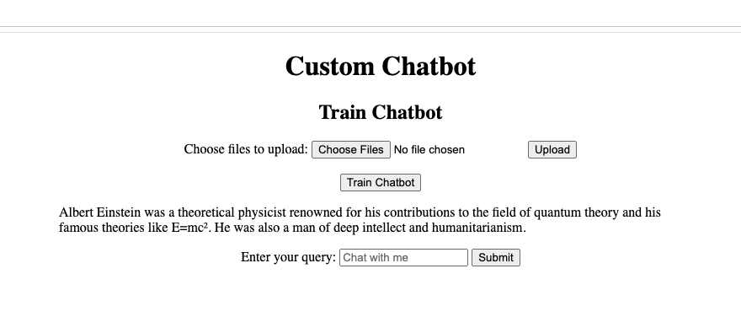
Chat with Your Files
from django.shortcuts import render
import ollama
from langchain_community.llms import Ollama
from langchain_community.document_loaders import DirectoryLoader, PyMuPDFLoader
from langchain_community.embeddings import OllamaEmbeddings
from langchain_community.vectorstores import FAISS
from langchain.text_splitter import RecursiveCharacterTextSplitter
import os
import shutil
from django.core.files.storage import default_storage
from langchain.prompts import ChatPromptTemplate
from langchain.chains import create_retrieval_chain
from langchain.chains.combine_documents import create_stuff_documents_chain
import requests
from django.http import JsonResponse
LLM_Model = 'gemma2:2b'
def LLM(prompt):
response = ollama.chat(model=LLM_Model, messages=[{'role': 'user', 'content': prompt}])
return response['message']['content']
def helloFunction(request):
userInput = request.GET.get('userInput')
response = LLM(userInput)
response = {"response": response}
return render(request, 'chatbot.html', response)
def customChatbot(request):
userInput = request.GET.get('userInput')
response = RAG(userInput)
response = {"response": response}
return render(request, 'customChatbot.html', response)
def upload_files(request):
if request.method == 'POST' and request.FILES.getlist('files[]'):
# Get the list of uploaded files
uploaded_files = request.FILES.getlist('files[]')
# Define the base directory where files will be saved
BASE_DIR = os.path.dirname(os.path.abspath(__file__))
DATA_PATH = os.path.join(BASE_DIR, 'data')
# Ensure the 'data' directory exists
if not os.path.exists(DATA_PATH):
os.makedirs(DATA_PATH)
# Process each file
success_messages = []
for uploaded_file in uploaded_files:
file_path = os.path.join(DATA_PATH, uploaded_file.name)
# Save the file to the 'data' directory
with default_storage.open(file_path, 'wb+') as destination:
for chunk in uploaded_file.chunks():
destination.write(chunk)
success_messages.append(f'File "{uploaded_file.name}" uploaded successfully!')
# Return a response indicating success for all files
alert = {'response': success_messages}
return render(request, 'customChatbot.html', alert)
else:
# If no files were uploaded, return an error
alert = {'error': 'No files uploaded.'}
return render(request, 'customChatbot.html', alert)
def RAG(user_input):
BASE_DIR = os.path.dirname(os.path.abspath(__file__))
FAISS_PATH = os.path.join(BASE_DIR, "faiss_index")
# Set up the local model
llm = Ollama(model=LLM_Model)
# Load the FAISS index with allow_dangerous_deserialization set to True
vector_store = FAISS.load_local(
FAISS_PATH,
OllamaEmbeddings(model=LLM_Model),
allow_dangerous_deserialization=True
)
# Set up the query prompt
prompt = ChatPromptTemplate.from_template(
"""
Answer the following question only based on the given context:
<context>
{context}
</context>
Question: {input}
""")
# Retrieve context from vector store
docs_chain = create_stuff_documents_chain(llm, prompt)
retriever = vector_store.as_retriever()
retrieval_chain = create_retrieval_chain(retriever, docs_chain)
# Perform the query
response = retrieval_chain.invoke({"input": user_input})
print(":::QUERY RESPONSE:::")
print(response["answer"])
return response["answer"]
def train(request):
def generate_data_store():
documents = load_documents()
chunks = split_text(documents)
save_to_faiss(chunks)
return JsonResponse({'status': 'success'})
def load_documents():
# Load documents from a local directory
loader = DirectoryLoader(DATA_PATH, glob="*.pdf", loader_cls=PyMuPDFLoader)
documents = loader.load()
return documents
def split_text(documents):
# Split documents into manageable chunks
text_splitter = RecursiveCharacterTextSplitter(
chunk_size=300,
chunk_overlap=100,
length_function=len,
add_start_index=True,)
chunks = text_splitter.split_documents(documents)
print(f"Split {len(documents)} documents into {len(chunks)} chunks.")
return chunks
def save_to_faiss(chunks):
# Clear out the database first
if os.path.exists(FAISS_PATH):
shutil.rmtree(FAISS_PATH)
# Create embeddings using Ollama's local model
embeddings = OllamaEmbeddings(model=LLM_Model)
# Initialize FAISS vector store
vector_store = FAISS.from_documents(chunks, embeddings)
# Save FAISS index
vector_store.save_local(FAISS_PATH)
print(f"Saved {len(chunks)} chunks to {FAISS_PATH} using FAISS.")
# Dynamically point to the 'data' folder in the same directory as this script
BASE_DIR = os.path.dirname(os.path.abspath(__file__))
FAISS_PATH = os.path.join(BASE_DIR, "faiss_index")
DATA_PATH = os.path.join(BASE_DIR, "data")
generate_data_store()
response = {'response': "Chatbot trained successfully!"} # Pass response to template
return render(request, 'customChatbot.html', response) # Render the HTML page with response
Use your documents to customize the chatbot
Create a new template customChatbot.html under templates folder
templates/customChatbot.html
from django.shortcuts import render
import ollama
from langchain_community.llms import Ollama
from langchain_community.document_loaders import DirectoryLoader, PyMuPDFLoader
from langchain_community.embeddings import OllamaEmbeddings
from langchain_community.vectorstores import FAISS
from langchain.text_splitter import RecursiveCharacterTextSplitter
import os
import shutil
from django.core.files.storage import default_storage
from langchain.prompts import ChatPromptTemplate
from langchain.chains import create_retrieval_chain
from langchain.chains.combine_documents import create_stuff_documents_chain
import requests
from django.http import JsonResponse
LLM_Model = 'gemma2:2b'
def LLM(prompt):
response = ollama.chat(model=LLM_Model, messages=[{'role': 'user', 'content': prompt}])
return response['message']['content']
def helloFunction(request):
userInput = request.GET.get('userInput')
response = LLM(userInput)
response = {"response": response}
return render(request, 'chatbot.html', response)
def customChatbot(request):
userInput = request.GET.get('userInput')
# Check if the FAISS index exists
BASE_DIR = os.path.dirname(os.path.abspath(__file__))
FAISS_PATH = os.path.join(BASE_DIR, "faiss_index", "index.faiss") # Add 'index.faiss' to path
if os.path.exists(FAISS_PATH):
# If the FAISS index exists, proceed with the RAG function
response = RAG(userInput)
else:
# If the FAISS index does not exist, prompt the user to train the chatbot first
response = "Please train the chatbot first."
response = {"response": response}
return render(request, 'customChatbot.html', response)
def upload_files(request):
if request.method == 'POST' and request.FILES.getlist('files[]'):
# Get the list of uploaded files
uploaded_files = request.FILES.getlist('files[]')
# Define the base directory where files will be saved
BASE_DIR = os.path.dirname(os.path.abspath(__file__))
DATA_PATH = os.path.join(BASE_DIR, 'data')
# Ensure the 'data' directory exists
if not os.path.exists(DATA_PATH):
os.makedirs(DATA_PATH)
# Process each file
success_messages = []
for uploaded_file in uploaded_files:
file_path = os.path.join(DATA_PATH, uploaded_file.name)
# Save the file to the 'data' directory
with default_storage.open(file_path, 'wb+') as destination:
for chunk in uploaded_file.chunks():
destination.write(chunk)
success_messages.append(f'File "{uploaded_file.name}" uploaded successfully!')
# Return a response indicating success for all files
alert = {'response': success_messages}
return render(request, 'customChatbot.html', alert)
else:
# If no files were uploaded, return an error
alert = {'error': 'No files uploaded.'}
return render(request, 'customChatbot.html', alert)
def RAG(user_input):
BASE_DIR = os.path.dirname(os.path.abspath(__file__))
FAISS_PATH = os.path.join(BASE_DIR, "faiss_index")
# Set up the local model
llm = Ollama(model=LLM_Model)
# Load the FAISS index with allow_dangerous_deserialization set to True
vector_store = FAISS.load_local(
FAISS_PATH,
OllamaEmbeddings(model=LLM_Model),
allow_dangerous_deserialization=True
)
# Set up the query prompt
prompt = ChatPromptTemplate.from_template(
"""
Answer the following question only based on the given context:
<context>
{context}
</context>
Question: {input}
""")
# Retrieve context from vector store
docs_chain = create_stuff_documents_chain(llm, prompt)
retriever = vector_store.as_retriever()
retrieval_chain = create_retrieval_chain(retriever, docs_chain)
# Perform the query
response = retrieval_chain.invoke({"input": user_input})
print(":::QUERY RESPONSE:::")
print(response["answer"])
return response["answer"]
def train(request):
def generate_data_store():
documents = load_documents()
chunks = split_text(documents)
save_to_faiss(chunks)
return JsonResponse({'status': 'success'})
def load_documents():
# Load documents from a local directory
loader = DirectoryLoader(DATA_PATH, glob="*.pdf", loader_cls=PyMuPDFLoader)
documents = loader.load()
return documents
def split_text(documents):
# Split documents into manageable chunks
text_splitter = RecursiveCharacterTextSplitter(
chunk_size=300,
chunk_overlap=100,
length_function=len,
add_start_index=True,
)
chunks = text_splitter.split_documents(documents)
print(f"Split {len(documents)} documents into {len(chunks)} chunks.")
return chunks
def save_to_faiss(chunks):
# Clear out the database first
if os.path.exists(FAISS_PATH):
shutil.rmtree(FAISS_PATH)
embeddings = OllamaEmbeddings(model=LLM_Model)
vector_store = FAISS.from_documents(chunks, embeddings)
vector_store.save_local(FAISS_PATH)
print(f"Saved {len(chunks)} chunks to {FAISS_PATH} using FAISS.")
# Dynamically point to the 'data' folder in the same directory as this script
BASE_DIR = os.path.dirname(os.path.abspath(__file__))
FAISS_PATH = os.path.join(BASE_DIR, "faiss_index")
DATA_PATH = os.path.join(BASE_DIR, "data")
generate_data_store()
response = {'response': "Chatbot trained successfully!"}
return render(request, 'customChatbot.html', response)
<!DOCTYPE html>
<html>
<head>
<title>LLM Response</title>
</head>
<body style="height: 100%; margin: 0; display: flex; justify-content: center; align-items: center;">
<div style="text-align: center;">
<h1>Custom Chatbot</h1>
<h2>Train Chatbot</h2>
<form method="POST" action="/upload" enctype="multipart/form-data">
{% csrf_token %}
<label for="file">Choose files to upload:</label>
<input type="file" id="file" name="files[]" multiple required>
<button type="submit">Upload</button>
</form>
<br />
<form method="POST" action="/train">
{% csrf_token %}
<button type="submit">Train Chatbot</button> {{ alert }}
</form>
<p>{{ response }}</p>
<form method="GET" action="{% url 'customChatbot' %}">
<label for="userInput">Enter your query:</label>
<input type="text" name="userInput" placeholder="Chat with me" required>
<button type="submit">Submit</button>
</form>
</div>
</body>
</html>
Edit the views.py file under ChatbotApp folder:
Edit the urls.py file under ChatbotApp folder:
from django.urls import path
from . import views
urlpatterns = [
path('', views.helloFunction, name='helloFunction'),
path('customChatbot', views.customChatbot, name='customChatbot'),
path('upload', views.upload_files, name='upload_files'),
path('train', views.train, name='train'),
]

Slide 38
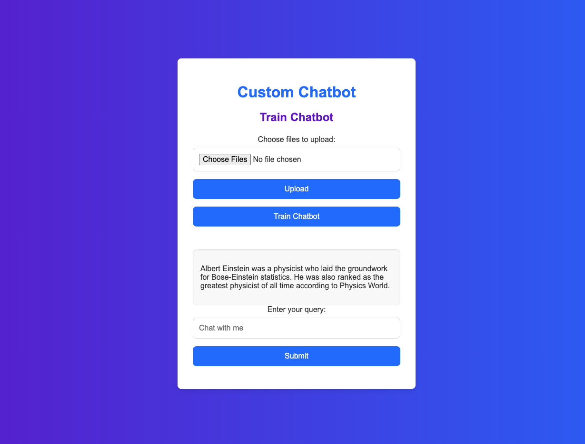
Make it look nicer
from django.shortcuts import render
import ollama
from langchain_community.llms import Ollama
from langchain_community.document_loaders import DirectoryLoader, PyMuPDFLoader
from langchain_community.embeddings import OllamaEmbeddings
from langchain_community.vectorstores import FAISS
from langchain.text_splitter import RecursiveCharacterTextSplitter
import os
import shutil
from django.core.files.storage import default_storage
from langchain.prompts import ChatPromptTemplate
from langchain.chains import create_retrieval_chain
from langchain.chains.combine_documents import create_stuff_documents_chain
import requests
from django.http import JsonResponse
LLM_Model = 'gemma2:2b'
def LLM(prompt):
response = ollama.chat(model=LLM_Model, messages=[{'role': 'user', 'content': prompt}])
return response['message']['content']
def helloFunction(request):
userInput = request.GET.get('userInput')
response = LLM(userInput)
response = {"response": response}
return render(request, 'chatbot.html', response)
def customChatbot(request):
userInput = request.GET.get('userInput')
response = RAG(userInput)
response = {"response": response}
return render(request, 'customChatbot.html', response)
def upload_files(request):
if request.method == 'POST' and request.FILES.getlist('files[]'):
# Get the list of uploaded files
uploaded_files = request.FILES.getlist('files[]')
# Define the base directory where files will be saved
BASE_DIR = os.path.dirname(os.path.abspath(__file__))
DATA_PATH = os.path.join(BASE_DIR, 'data')
# Ensure the 'data' directory exists
if not os.path.exists(DATA_PATH):
os.makedirs(DATA_PATH)
# Process each file
success_messages = []
for uploaded_file in uploaded_files:
file_path = os.path.join(DATA_PATH, uploaded_file.name)
# Save the file to the 'data' directory
with default_storage.open(file_path, 'wb+') as destination:
for chunk in uploaded_file.chunks():
destination.write(chunk)
success_messages.append(f'File "{uploaded_file.name}" uploaded successfully!')
# Return a response indicating success for all files
alert = {'response': success_messages}
return render(request, 'customChatbot.html', alert)
else:
# If no files were uploaded, return an error
alert = {'error': 'No files uploaded.'}
return render(request, 'customChatbot.html', alert)
def RAG(user_input):
BASE_DIR = os.path.dirname(os.path.abspath(__file__))
FAISS_PATH = os.path.join(BASE_DIR, "faiss_index")
# Set up the local model
llm = Ollama(model=LLM_Model)
# Load the FAISS index with allow_dangerous_deserialization set to True
vector_store = FAISS.load_local(
FAISS_PATH,
OllamaEmbeddings(model=LLM_Model),
allow_dangerous_deserialization=True
)
# Set up the query prompt
prompt = ChatPromptTemplate.from_template(
"""
Answer the following question only based on the given context:
<context>
{context}
</context>
Question: {input}
""")
# Retrieve context from vector store
docs_chain = create_stuff_documents_chain(llm, prompt)
retriever = vector_store.as_retriever()
retrieval_chain = create_retrieval_chain(retriever, docs_chain)
# Perform the query
response = retrieval_chain.invoke({"input": user_input})
print(":::QUERY RESPONSE:::")
print(response["answer"])
return response["answer"]
def train(request):
def generate_data_store():
documents = load_documents()
chunks = split_text(documents)
save_to_faiss(chunks)
return JsonResponse({'status': 'success'})
def load_documents():
# Load documents from a local directory
loader = DirectoryLoader(DATA_PATH, glob="*.pdf", loader_cls=PyMuPDFLoader)
documents = loader.load()
return documents
def split_text(documents):
# Split documents into manageable chunks
text_splitter = RecursiveCharacterTextSplitter(
chunk_size=300,
chunk_overlap=100,
length_function=len,
add_start_index=True,)
chunks = text_splitter.split_documents(documents)
print(f"Split {len(documents)} documents into {len(chunks)} chunks.")
return chunks
def save_to_faiss(chunks):
# Clear out the database first
if os.path.exists(FAISS_PATH):
shutil.rmtree(FAISS_PATH)
# Create embeddings using Ollama's local model
embeddings = OllamaEmbeddings(model=LLM_Model)
# Initialize FAISS vector store
vector_store = FAISS.from_documents(chunks, embeddings)
# Save FAISS index
vector_store.save_local(FAISS_PATH)
print(f"Saved {len(chunks)} chunks to {FAISS_PATH} using FAISS.")
# Dynamically point to the 'data' folder in the same directory as this script
BASE_DIR = os.path.dirname(os.path.abspath(__file__))
FAISS_PATH = os.path.join(BASE_DIR, "faiss_index")
DATA_PATH = os.path.join(BASE_DIR, "data")
generate_data_store()
response = {'response': "Chatbot trained successfully!"} # Pass response to template
return render(request, 'customChatbot.html', response) # Render the HTML page with response
<!DOCTYPE html>
<html lang="en">
<head>
<meta charset="UTF-8">
<meta name="viewport" content="width=device-width, initial-scale=1.0">
<title>LLM Response</title>
<style>
:root {
--primary-color: #2575fc;
--secondary-color: #6a11cb;
--background-gradient: linear-gradient(to right, #6a11cb, #2575fc);
--text-color: #333;
--button-color: #fff;
--button-hover-bg: #4c9fff;
--input-border: #ddd;
--border-radius: 8px;
}
* {
box-sizing: border-box;
}
body {
height: 100vh;
margin: 0;
font-family: 'Arial', sans-serif;
display: flex;
justify-content: center;
align-items: center;
background: var(--background-gradient);
color: var(--text-color);
}
.container {
background-color: #fff;
padding: 2rem;
border-radius: var(--border-radius);
box-shadow: 0 4px 10px rgba(0, 0, 0, 0.1);
width: 100%;
max-width: 500px;
text-align: center;
}
h1 {
font-size: 2rem;
color: var(--primary-color);
margin-bottom: 1rem;
}
h2 {
font-size: 1.5rem;
color: var(--secondary-color);
margin-bottom: 1.5rem;
}
label {
display: block;
margin-bottom: 0.5rem;
font-size: 1rem;
}
input[type="file"],
input[type="text"] {
width: 100%;
padding: 0.75rem;
margin-bottom: 1rem;
border: 1px solid var(--input-border);
border-radius: var(--border-radius);
font-size: 1rem;
}
button {
background-color: var(--primary-color);
color: var(--button-color);
padding: 0.75rem 1.5rem;
border: none;
border-radius: var(--border-radius);
font-size: 1rem;
cursor: pointer;
transition: background-color 0.3s ease;
margin-bottom: 1rem;
width: 100%;
}
button:hover {
background-color: var(--button-hover-bg);
}
.response-container {
margin-top: 2rem;
padding: 1rem;
background-color: #f9f9f9;
border-radius: var(--border-radius);
box-shadow: inset 0 1px 3px rgba(0, 0, 0, 0.1);
text-align: left;
max-width: 100%;
}
</style>
</head>
<body>
<div class="container">
<h1>Custom Chatbot</h1>
<h2>Train Chatbot</h2>
<form method="POST" action="/upload" enctype="multipart/form-data">
{% csrf_token %}
<label for="file">Choose files to upload:</label>
<input type="file" id="file" name="files[]" multiple required>
<button type="submit">Upload</button>
</form>
<form method="POST" action="/train">
{% csrf_token %}
<button type="submit">Train Chatbot</button> {{ alert }}
</form>
<div class="response-container">
<p>{{ response }}</p>
</div>
<form method="GET" action="{% url 'customChatbot' %}">
<label for="userInput">Enter your query:</label>
<input type="text" name="userInput" placeholder="Chat with me" required>
<button type="submit">Submit</button>
</form>
</div>
</body>
</html>
Update template customChatbot.html under templates folder
templates/customChatbot.html

Slide 39
Bonus: Weather App
Provide suggestion on what to wear based on weather prediction
views.py
templates/weather.html
urls.py
from django.shortcuts import render
import ollama
from langchain_community.llms import Ollama
from langchain_community.document_loaders import DirectoryLoader, PyMuPDFLoader
from langchain_community.embeddings import OllamaEmbeddings
from langchain_community.vectorstores import FAISS
from langchain.text_splitter import RecursiveCharacterTextSplitter
import os
import shutil
from django.core.files.storage import default_storage
from langchain.prompts import ChatPromptTemplate
from langchain.chains import create_retrieval_chain
from langchain.chains.combine_documents import create_stuff_documents_chain
import requests
from django.http import JsonResponse
LLM_Model = 'gemma2:2b'
def LLM(prompt):
response = ollama.chat(model=LLM_Model, messages=[{'role': 'user', 'content': prompt}])
return response['message']['content']
def helloFunction(request):
userInput = request.GET.get('userInput')
response = LLM(userInput)
response = {"response": response}
return render(request, 'chatbot.html', response)
def customChatbot(request):
userInput = request.GET.get('userInput')
response = RAG(userInput)
response = {"response": response}
return render(request, 'customChatbot.html', response)
def upload_files(request):
if request.method == 'POST' and request.FILES.getlist('files[]'):
# Get the list of uploaded files
uploaded_files = request.FILES.getlist('files[]')
# Define the base directory where files will be saved
BASE_DIR = os.path.dirname(os.path.abspath(__file__))
DATA_PATH = os.path.join(BASE_DIR, 'data')
# Ensure the 'data' directory exists
if not os.path.exists(DATA_PATH):
os.makedirs(DATA_PATH)
# Process each file
success_messages = []
for uploaded_file in uploaded_files:
file_path = os.path.join(DATA_PATH, uploaded_file.name)
# Save the file to the 'data' directory
with default_storage.open(file_path, 'wb+') as destination:
for chunk in uploaded_file.chunks():
destination.write(chunk)
success_messages.append(f'File "{uploaded_file.name}" uploaded successfully!')
# Return a response indicating success for all files
alert = {'response': success_messages}
return render(request, 'customChatbot.html', alert)
else:
# If no files were uploaded, return an error
alert = {'error': 'No files uploaded.'}
return render(request, 'customChatbot.html', alert)
def RAG(user_input):
BASE_DIR = os.path.dirname(os.path.abspath(__file__))
FAISS_PATH = os.path.join(BASE_DIR, "faiss_index")
# Set up the local model
llm = Ollama(model=LLM_Model)
# Load the FAISS index with allow_dangerous_deserialization set to True
vector_store = FAISS.load_local(
FAISS_PATH,
OllamaEmbeddings(model=LLM_Model),
allow_dangerous_deserialization=True
)
# Set up the query prompt
prompt = ChatPromptTemplate.from_template(
"""
Answer the following question only based on the given context:
<context>
{context}
</context>
Question: {input}
""")
# Retrieve context from vector store
docs_chain = create_stuff_documents_chain(llm, prompt)
retriever = vector_store.as_retriever()
retrieval_chain = create_retrieval_chain(retriever, docs_chain)
# Perform the query
response = retrieval_chain.invoke({"input": user_input})
print(":::QUERY RESPONSE:::")
print(response["answer"])
return response["answer"]
def train(request):
def generate_data_store():
documents = load_documents()
chunks = split_text(documents)
save_to_faiss(chunks)
return JsonResponse({'status': 'success'})
def load_documents():
# Load documents from a local directory
loader = DirectoryLoader(DATA_PATH, glob="*.pdf", loader_cls=PyMuPDFLoader)
documents = loader.load()
return documents
def split_text(documents):
# Split documents into manageable chunks
text_splitter = RecursiveCharacterTextSplitter(
chunk_size=300,
chunk_overlap=100,
length_function=len,
add_start_index=True,)
chunks = text_splitter.split_documents(documents)
print(f"Split {len(documents)} documents into {len(chunks)} chunks.")
return chunks
def save_to_faiss(chunks):
# Clear out the database first
if os.path.exists(FAISS_PATH):
shutil.rmtree(FAISS_PATH)
# Create embeddings using Ollama's local model
embeddings = OllamaEmbeddings(model=LLM_Model)
# Initialize FAISS vector store
vector_store = FAISS.from_documents(chunks, embeddings)
# Save FAISS index
vector_store.save_local(FAISS_PATH)
print(f"Saved {len(chunks)} chunks to {FAISS_PATH} using FAISS.")
# Dynamically point to the 'data' folder in the same directory as this script
BASE_DIR = os.path.dirname(os.path.abspath(__file__))
FAISS_PATH = os.path.join(BASE_DIR, "faiss_index")
DATA_PATH = os.path.join(BASE_DIR, "data")
generate_data_store()
response = {'response': "Chatbot trained successfully!"} # Pass response to template
return render(request, 'customChatbot.html', response) # Render the HTML page with response
def weather(request):
try:
ip_address = request.GET.get('ip_address') # Default IP address if not provided
tone = request.GET.get('tone', 'normal') # Default tone if not provided
# Get coordinates based on IP address
coordinate = get_coordinate_from_ip(ip_address)
# Fetch weather forecast
foreCast = requests.get(f"https://api.weather.gov/points/{coordinate[0]},{coordinate[1]}")
# Fetch location details (city, state, country)
location_info = get_ip_geolocation(ip_address)
city = location_info.get('city', 'Unknown City')
state = location_info.get('region', 'Unknown State')
country = location_info.get('country', 'Unknown Country')
location_str = f"{city}, {state}, {country}"
# Fetch weather forecast details
forecastUrl = foreCast.json()["properties"]["forecast"]
forecastContent = requests.get(f"{forecastUrl}").json()
first_period_detailed_forecast = forecastContent["properties"]["periods"][0]["detailedForecast"]
# Construct query for LLM
query = f"""
You are a helpful assistant. Given the following weather conditions:
{first_period_detailed_forecast},
please provide a suggestion on what to wear.
Note: say it in a {tone} way.
"""
# Generate response from LLM
response_content = LLM(query)
# Pass the response and location details to the template
context = {
'response': response_content,
'location': location_str
}
# Render the HTML page with the response and location information
return render(request, 'weather.html', context)
except Exception as e:
print(f"An error occurred: {e}")
return render(request, 'weather.html', {'error': 'An error occurred. Please try again later.'})
def get_coordinate_from_ip(ip_address):
try:
response = requests.get(f"https://ipinfo.io/{ip_address}/json")
data = response.json()
if "loc" in data:
loc = data["loc"]
latitude, longitude = loc.split(",")
return float(latitude), float(longitude)
else:
print("Location information is not available for this IP address.")
return None
except Exception as e:
print(f"An error occurred: {e}")
return None
def get_ip_geolocation(ip_address):
url = f'http://ip-api.com/json/{ip_address}'
response = requests.get(url)
data = response.json()
if data['status'] == 'success':
return {
'ip': data.get('query'),
'city': data.get('city'),
'region': data.get('regionName'),
'country': data.get('country'),
'location': f"{data.get('lat')}, {data.get('lon')}",
'postal': data.get('zip'),
'timezone': data.get('timezone')
}
else:
return {"error": "Could not retrieve data"}
<!DOCTYPE html>
<html>
<head>
<title>AI Weather Assistant</title>
</head>
<body style="height: 100%; margin: 0; display: flex; justify-content: center; align-items: center;">
<div style="text-align: center;">
<script>
document.addEventListener('DOMContentLoaded', function() {
// Check if the ip-hidden input is empty, then fetch the IP
const ipInput = document.getElementById('ip-hidden');
if (!ipInput.value) {
fetch('https://api.ipify.org?format=json')
.then(response => response.json())
.then(data => {
ipInput.value = data.ip;
})
.catch(error => console.error('Error fetching IP:', error));
}
});
</script>
<h1>AI Weather Assistant</h1>
<form method="GET" action="{% url 'weather' %}">
<label for="ip">IP Address:</label>
<input type="text" id="ip-hidden" name="ip_address" placeholder="IP address" value="{{ ip_address|default_if_none:'' }}" required> {{ location }}
<br>
<label for="tone">Enter the tone:</label>
<input type="text" name="tone" placeholder="set a tone for response" value="{{ tone|default:'normal' }}" required>
<button type="submit">Submit</button>
</form>
<div style="width: 40%; margin: 0 auto; text-align: left;">
<p>{{ response }}</p>
</div>
</div>
</body>
</html>
from django.urls import path
from . import views
urlpatterns = [
path('', views.helloFunction, name='helloFunction'),
path('customChatbot', views.customChatbot, name='customChatbot'),
path('upload', views.upload_files, name='upload_files'),
path('train', views.train, name='train'),
path('weather/', views.weather, name='weather'),
]

Slide 40
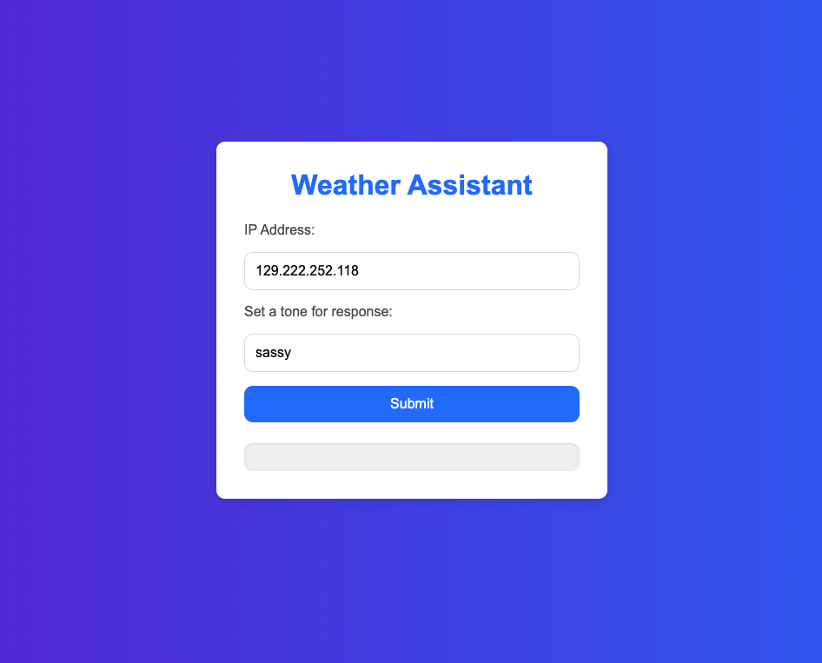
Make it look nicer
from django.shortcuts import render
import ollama
from langchain_community.llms import Ollama
from langchain_community.document_loaders import DirectoryLoader, PyMuPDFLoader
from langchain_community.embeddings import OllamaEmbeddings
from langchain_community.vectorstores import FAISS
from langchain.text_splitter import RecursiveCharacterTextSplitter
import os
import shutil
from django.core.files.storage import default_storage
from langchain.prompts import ChatPromptTemplate
from langchain.chains import create_retrieval_chain
from langchain.chains.combine_documents import create_stuff_documents_chain
import requests
from django.http import JsonResponse
LLM_Model = 'gemma2:2b'
def LLM(prompt):
response = ollama.chat(model=LLM_Model, messages=[{'role': 'user', 'content': prompt}])
return response['message']['content']
def helloFunction(request):
userInput = request.GET.get('userInput')
response = LLM(userInput)
response = {"response": response}
return render(request, 'chatbot.html', response)
def customChatbot(request):
userInput = request.GET.get('userInput')
response = RAG(userInput)
response = {"response": response}
return render(request, 'customChatbot.html', response)
def upload_files(request):
if request.method == 'POST' and request.FILES.getlist('files[]'):
# Get the list of uploaded files
uploaded_files = request.FILES.getlist('files[]')
# Define the base directory where files will be saved
BASE_DIR = os.path.dirname(os.path.abspath(__file__))
DATA_PATH = os.path.join(BASE_DIR, 'data')
# Ensure the 'data' directory exists
if not os.path.exists(DATA_PATH):
os.makedirs(DATA_PATH)
# Process each file
success_messages = []
for uploaded_file in uploaded_files:
file_path = os.path.join(DATA_PATH, uploaded_file.name)
# Save the file to the 'data' directory
with default_storage.open(file_path, 'wb+') as destination:
for chunk in uploaded_file.chunks():
destination.write(chunk)
success_messages.append(f'File "{uploaded_file.name}" uploaded successfully!')
# Return a response indicating success for all files
alert = {'response': success_messages}
return render(request, 'customChatbot.html', alert)
else:
# If no files were uploaded, return an error
alert = {'error': 'No files uploaded.'}
return render(request, 'customChatbot.html', alert)
def RAG(user_input):
BASE_DIR = os.path.dirname(os.path.abspath(__file__))
FAISS_PATH = os.path.join(BASE_DIR, "faiss_index")
# Set up the local model
llm = Ollama(model=LLM_Model)
# Load the FAISS index with allow_dangerous_deserialization set to True
vector_store = FAISS.load_local(
FAISS_PATH,
OllamaEmbeddings(model=LLM_Model),
allow_dangerous_deserialization=True
)
# Set up the query prompt
prompt = ChatPromptTemplate.from_template(
"""
Answer the following question only based on the given context:
<context>
{context}
</context>
Question: {input}
""")
# Retrieve context from vector store
docs_chain = create_stuff_documents_chain(llm, prompt)
retriever = vector_store.as_retriever()
retrieval_chain = create_retrieval_chain(retriever, docs_chain)
# Perform the query
response = retrieval_chain.invoke({"input": user_input})
print(":::QUERY RESPONSE:::")
print(response["answer"])
return response["answer"]
def train(request):
def generate_data_store():
documents = load_documents()
chunks = split_text(documents)
save_to_faiss(chunks)
return JsonResponse({'status': 'success'})
def load_documents():
# Load documents from a local directory
loader = DirectoryLoader(DATA_PATH, glob="*.pdf", loader_cls=PyMuPDFLoader)
documents = loader.load()
return documents
def split_text(documents):
# Split documents into manageable chunks
text_splitter = RecursiveCharacterTextSplitter(
chunk_size=300,
chunk_overlap=100,
length_function=len,
add_start_index=True,)
chunks = text_splitter.split_documents(documents)
print(f"Split {len(documents)} documents into {len(chunks)} chunks.")
return chunks
def save_to_faiss(chunks):
# Clear out the database first
if os.path.exists(FAISS_PATH):
shutil.rmtree(FAISS_PATH)
# Create embeddings using Ollama's local model
embeddings = OllamaEmbeddings(model=LLM_Model)
# Initialize FAISS vector store
vector_store = FAISS.from_documents(chunks, embeddings)
# Save FAISS index
vector_store.save_local(FAISS_PATH)
print(f"Saved {len(chunks)} chunks to {FAISS_PATH} using FAISS.")
# Dynamically point to the 'data' folder in the same directory as this script
BASE_DIR = os.path.dirname(os.path.abspath(__file__))
FAISS_PATH = os.path.join(BASE_DIR, "faiss_index")
DATA_PATH = os.path.join(BASE_DIR, "data")
generate_data_store()
response = {'response': "Chatbot trained successfully!"} # Pass response to template
return render(request, 'customChatbot.html', response) # Render the HTML page with response
Update template weather.html under templates folder
<!DOCTYPE html>
<html lang="en">
<head>
<meta charset="UTF-8">
<meta name="viewport" content="width=device-width, initial-scale=1.0">
<title>Clothing Suggestion</title>
<style>
body {
margin: 0;
padding: 0;
font-family: 'Arial', sans-serif;
height: 100vh;
display: flex;
justify-content: center;
align-items: center;
background: linear-gradient(to right, #fcfcfc, #f6f7f7); /* Gradient background */
}
.container {
background-color: #fff;
padding: 20px;
border-radius: 10px;
box-shadow: 0 4px 8px rgba(0, 0, 0, 0.1);
width: 100%;
max-width: 500px;
text-align: center;
}
h1 {
color: #333;
font-size: 24px;
margin-bottom: 20px;
}
form {
margin-bottom: 20px;
}
label {
font-size: 14px;
color: #555;
display: block;
margin: 10px 0 5px;
}
input[type="text"] {
width: 80%;
padding: 10px;
border: 1px solid #ddd;
border-radius: 5px;
font-size: 14px;
margin-bottom: 10px;
}
button {
background-color: #2193b0;
color: white;
padding: 10px 20px;
border: none;
border-radius: 5px;
font-size: 14px;
cursor: pointer;
transition: background-color 0.3s;
}
button:hover {
background-color: #6dd5ed;
}
.response-box {
margin-top: 20px;
text-align: left;
color: #555;
background-color: #f9f9f9;
padding: 15px;
border-radius: 5px;
box-shadow: inset 0 1px 3px rgba(0, 0, 0, 0.1);
}
p {
margin: 0;
}
</style>
</head>
<body>
<div class="container">
<h1>Weather Assistant</h1>
<form method="GET" action="{% url 'weather' %}">
<label for="ip">IP Address:</label>
<input type="text" id="ip-hidden" name="ip_address" placeholder="IP address" value="{{ ip_address|default_if_none:'' }}" required>
<br />
{{ location }}
<label for="tone">Enter the tone:</label>
<input type="text" name="tone" placeholder="set a tone for response" value="{{ tone|default:'sassy' }}" required>
<button type="submit">Submit</button>
</form>
<div class="response-box">
<p>{{ response }}</p>
</div>
</div>
<script>
document.addEventListener('DOMContentLoaded', function() {
// Check if the ip-hidden input is empty, then fetch the IP
const ipInput = document.getElementById('ip-hidden');
if (!ipInput.value) {
fetch('https://api.ipify.org?format=json')
.then(response => response.json())
.then(data => {
ipInput.value = data.ip;
})
.catch(error => console.error('Error fetching IP:', error));
}
});
</script>
</body>
</html>
templates/weather.html

Slide 41
Summary
Used Django to build a website
Used Ollama to load an LLM
Customized a Chatbot
Built a Weather App with APIs and LLM

Slide 42
Further Resources
W3School: https://www.w3schools.com/
Django: https://www.djangoproject.com/
React: https://react.dev/
MySQL: https://www.mysql.com/
Neo4j: https://neo4j.com/

Slide 43
Supplemental Information

Slide 44
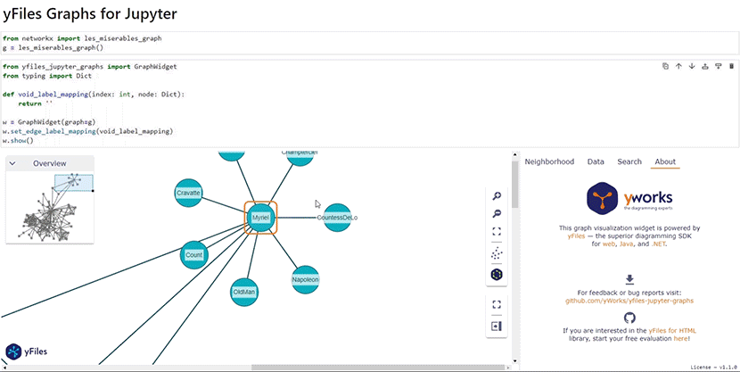
A Graph Diagram Visualization Tool
https://github.com/yWorks/yfiles-jupyter-graphs/tree/main?tab=readme-ov-file

Slide 45
Port Issue
To run the python manage.py runserver code to view on browser, there will be an error:
Error: That port is already in use.
To solve this problem there are two ways:
Terminate the process previous running in the port (e.g., 8000)
lsof -i : 8000 (to find the PID of the process)
kill -9 PID
(windows:
1. netstat -ano | findstr :8000
2. taskkill /PID 8000 /f)
Run the server on a new port:
python manage.py runserver 8081
Access http://127.0.0.1:8000/ from a browser, now you have successfully pass information from Django to the browser

Slide 46
Create Environment from requirements.txt File
In terminal (Anaconda Prompt on Windows), type the command below and press ENTER key:
conda create --name GRAPH
Activate the Virtual Environment:
conda activate GRAPH
Install pip:
conda install pip
Install required packages:
pip install –r requirements.txt
aiohappyeyeballs==2.4.0
aiohttp==3.10.5
aiosignal==1.3.1
annotated-types==0.7.0
anyio==4.4.0
asgiref==3.8.1
attrs==24.2.0
certifi==2024.8.30
charset-normalizer==3.3.2
dataclasses-json==0.6.7
Django==5.1.1
faiss-cpu==1.8.0.post1
frozenlist==1.4.1
greenlet==3.1.1
h11==0.14.0
httpcore==1.0.5
httpx==0.27.2
idna==3.10
jsonpatch==1.33
jsonpointer==3.0.0
langchain==0.3.0
langchain-community==0.3.0
langchain-core==0.3.5
langchain-text-splitters==0.3.0
langsmith==0.1.125
marshmallow==3.22.0
multidict==6.1.0
mypy-extensions==1.0.0
numpy==1.26.4
ollama==0.3.3
orjson==3.10.7
packaging==24.1
pydantic==2.9.2
pydantic-settings==2.5.2
pydantic_core==2.23.4
PyMuPDF==1.24.10
PyMuPDFb==1.24.10
python-dotenv==1.0.1
PyYAML==6.0.2
requests==2.32.3
setuptools==72.1.0
sniffio==1.3.1
SQLAlchemy==2.0.35
sqlparse==0.5.1
tenacity==8.5.0
typing-inspect==0.9.0
typing_extensions==4.12.2
urllib3==2.2.3
wheel==0.44.0
yarl==1.11.1
If there is a “OpenSSL” related error when creating the environment:
This is due to .dll error
go to location where you've installed Anaconda Anaconda3>Library>bin. search and copy following dll files
libcrypto-1_1-x64.dll libssl-1_1-x64.dll
and paste to: Anaconda3>DLLs
then restart your terminal (or computer)
issue will get resolved.

Slide 47
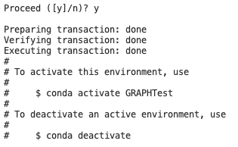
Create Virtual Environment from YML File
name: LLM
channels:
- defaults
dependencies:
- bzip2=1.0.8=h6c40b1e_6
- ca-certificates=2024.7.2=hecd8cb5_0
- expat=2.6.3=h6d0c2b6_0
- libcxx=14.0.6=h9765a3e_0
- libffi=3.4.4=hecd8cb5_1
- ncurses=6.4=hcec6c5f_0
- openssl=3.0.15=h46256e1_0
- pip=24.2=py312hecd8cb5_0
- python=3.12.3=hd58486a_1
- readline=8.2=hca72f7f_0
- setuptools=72.1.0=py312hecd8cb5_0
- sqlite=3.45.3=h6c40b1e_0
- tk=8.6.14=h4d00af3_0
- tzdata=2024a=h04d1e81_0
- wheel=0.44.0=py312hecd8cb5_0
- xz=5.4.6=h6c40b1e_1
- zlib=1.2.13=h4b97444_1
- pip:
- aiohappyeyeballs==2.4.0
- aiohttp==3.10.5
- aiosignal==1.3.1
- annotated-types==0.7.0
- anyio==4.4.0
- asgiref==3.8.1
- attrs==24.2.0
- certifi==2024.8.30
- charset-normalizer==3.3.2
- dataclasses-json==0.6.7
- django==5.1.1
- faiss-cpu==1.8.0.post1
- frozenlist==1.4.1
- greenlet==3.1.1
- h11==0.14.0
- httpcore==1.0.5
- httpx==0.27.2
- idna==3.10
- jsonpatch==1.33
- jsonpointer==3.0.0
- langchain==0.3.0
- langchain-community==0.3.0
- langchain-core==0.3.5
- langchain-text-splitters==0.3.0
- langsmith==0.1.125
- marshmallow==3.22.0
- multidict==6.1.0
- mypy-extensions==1.0.0
- numpy==1.26.4
- ollama==0.3.3
- orjson==3.10.7
- packaging==24.1
- pydantic==2.9.2
- pydantic-core==2.23.4
- pydantic-settings==2.5.2
- pymupdf==1.24.10
- pymupdfb==1.24.10
- python-dotenv==1.0.1
- pyyaml==6.0.2
- requests==2.32.3
- sniffio==1.3.1
- sqlalchemy==2.0.35
- sqlparse==0.5.1
- tenacity==8.5.0
- typing-extensions==4.12.2
- typing-inspect==0.9.0
- urllib3==2.2.3
- yarl==1.11.1
In terminal (Anaconda Prompt on Windows), type the command below and press ENTER key:
conda env create -f environment.yml
When the environment is created, you will see:
Activate the Virtual Environment:
conda activate GRAPH
If you see “(GRAPH)” at the beginning,
it means the GRAPH environment is activated:

Slide 48
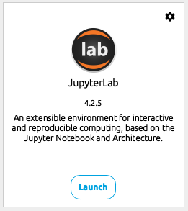
Install JupyterLAB
Install Jupyter Notebook
Launch JupyterLAB

Slide 49
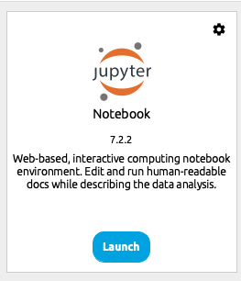
Install Jupyter Notebook
Install Jupyter Notebook
Launch Jupyter Notebook

